Slide 1
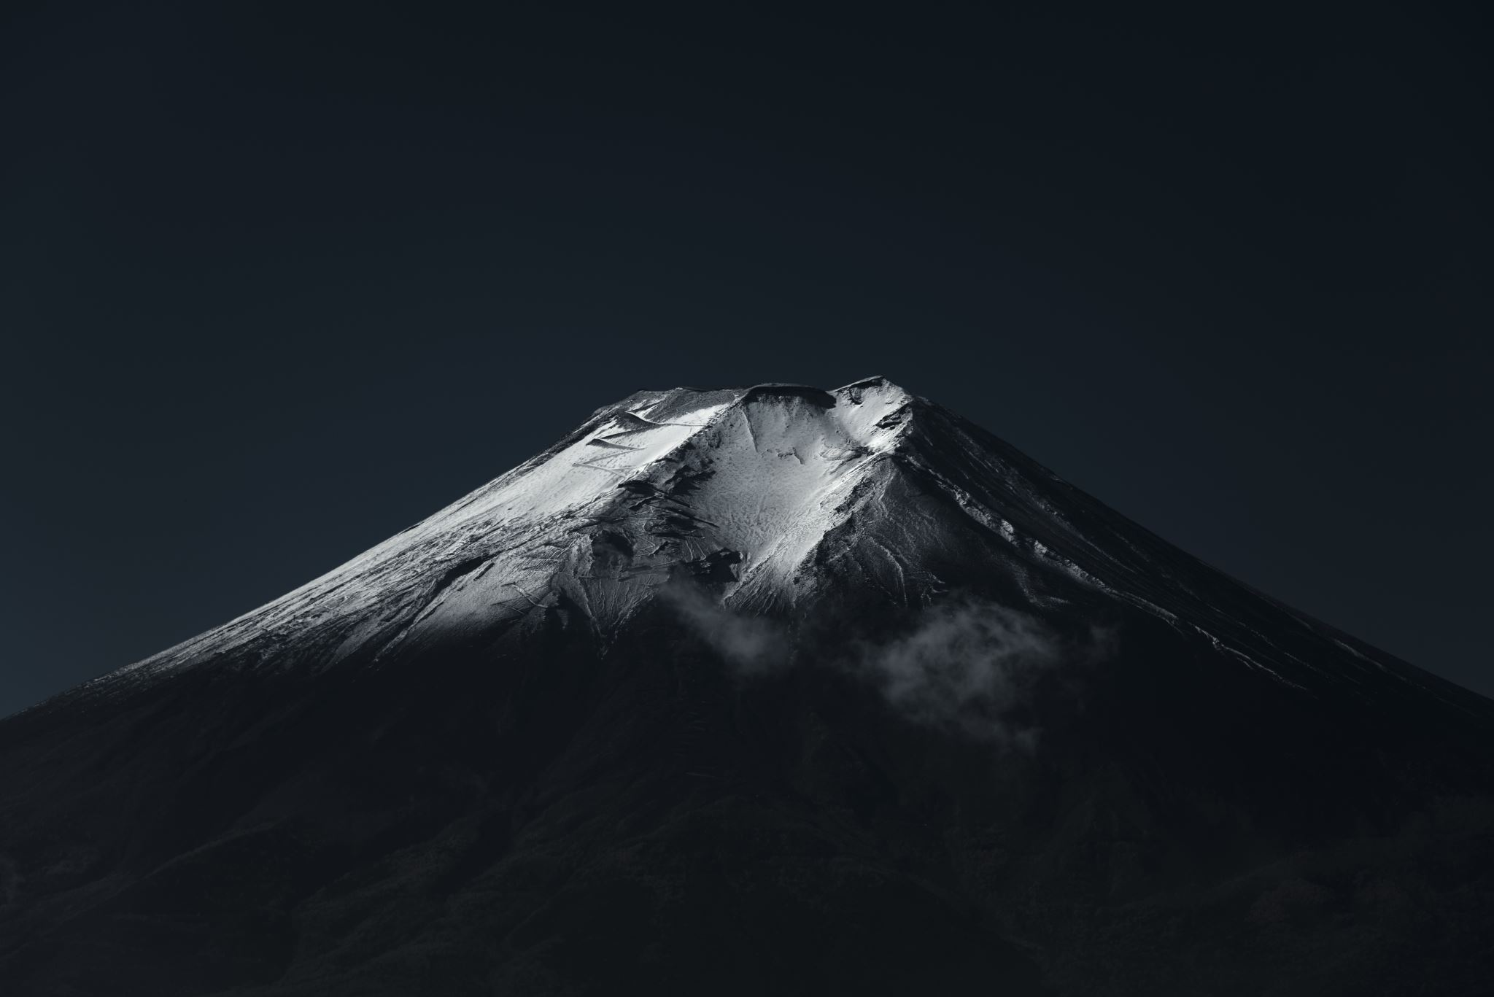
Volcanoes
Volcanoes have varied shapes and sizes, but are divided into categories depending on the
the shape,
type of material that reaches the surface and
the type of eruption that happens.

Slide 2
Volcanic Vocabulary
Viscosity – stickiness Liquids with higher viscosity, like honey, flow slower than those with lower viscosity, like water. This property is influenced by factors such as temperature, pressure, and the type of fluid
Volcanology the study of volcanoes, lava, magma and related sciences
3. Cinder Cones Small, cone-shaped mounds of ash and rocks
4. Composite Volcano (Stratovolcano) Tall, steep, and built from layers of lava and ash.
5. Shield Volcano Large and gently sloped, formed by flowing lava
6. Lava Domes Sticky, thick lava that forms a dome shape.
7. Active Volcanoes A volcano that is currently erupting or has erupted in historical time. Kīlauea in Hawaii, Mount Etna in Italy, and Mount Stromboli in Italy.
8. Dormant Volcanoes A volcano that is not currently erupting but is expected to do so in the future. These can be "restless" systems with signs of heat and magma activity. Mount Rainier in the U.S. and Mount Kilimanjaro in Tanzania are considered dormant.
9. Extinct Volcanoes A volcano that is not expected to erupt again. Their magma supply has been cut off due to factors like tectonic plate movement, and they show no signs of volcanic activity. Capulin Volcano in the U.S.

Slide 3
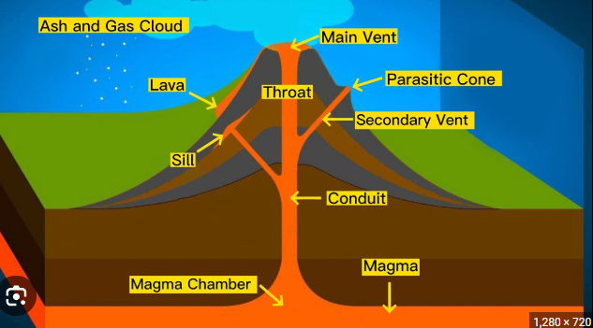
Parts of a Volcano
https://www.youtube.com/watch?v=-L1DAmrufRI

Slide 4
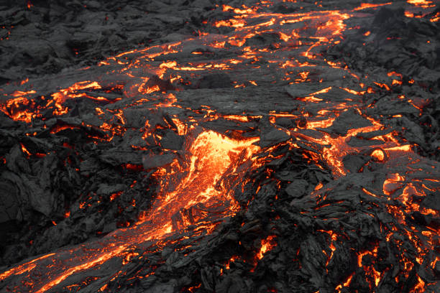
Is there a difference between Lava and Magma?

Slide 5
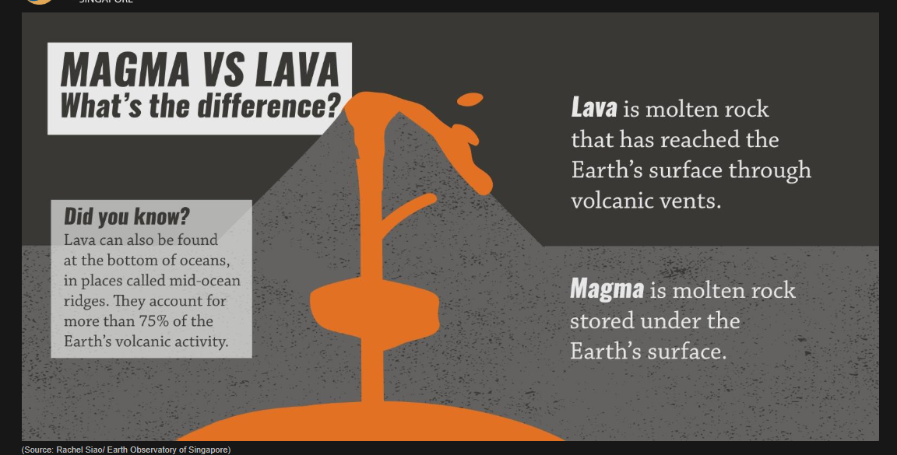
YES, based on location.
Lava is magma that has erupted onto the surface.
Magma
molten rock found beneath the Earth's surface.

Slide 6
Types of Volcanoes
There are 4 main types of volcanoes:
Stratovolcanoes
Shield volcanoes
Cinder cones
Lava Domes
There are many ways to classify volcanoes
based on shape and types of eruptions.
We will focus on these four.

Slide 7
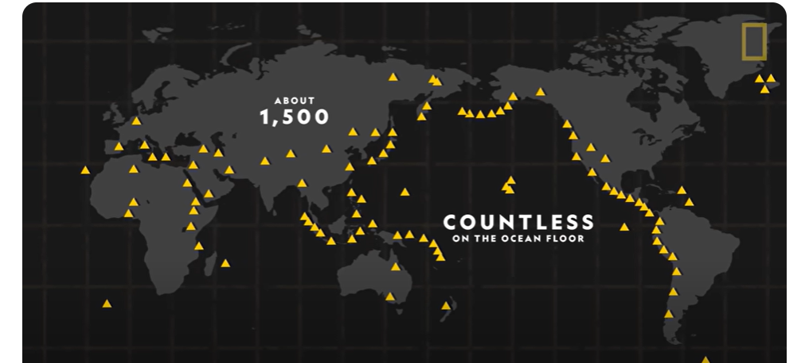
About 1,500 active volcanoes can be found around the world.

Slide 8
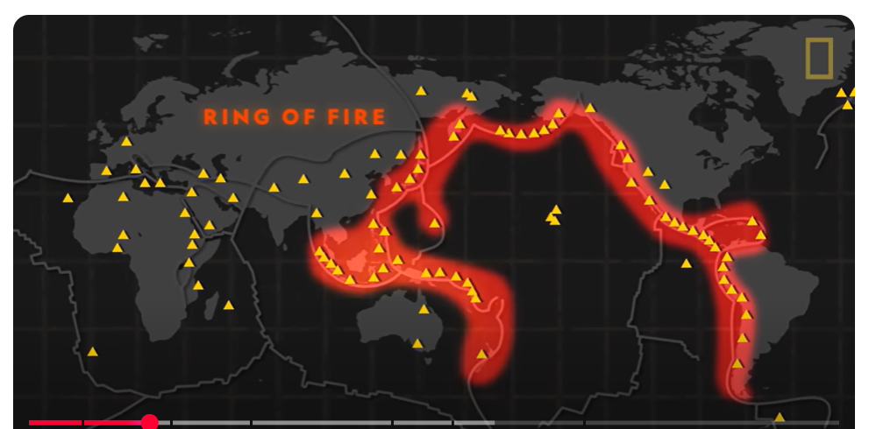
https://www.youtube.com/watch?v=VNGUdObDoLk
Volcanoes 101 | National Geographic
The Ring of Fire is a horseshoe-shaped area around the Pacific Ocean where many volcanoes and earthquakes happen because giant pieces of Earth's crust, called tectonic plates, crash into each other.

Slide 9
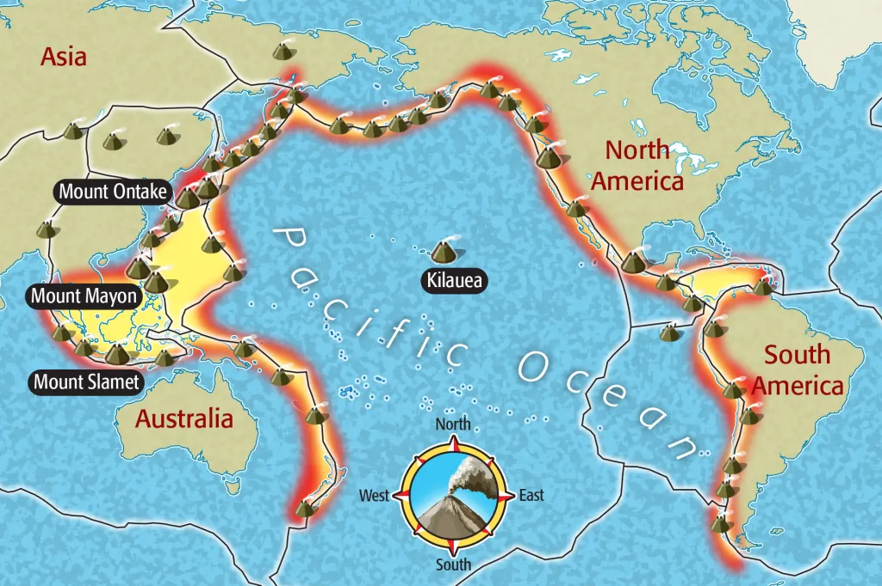

Slide 10
The Four Main Types of Volcanoes
1. Cinder Cones
Small, cone-shaped mounds of ash and rocks
2. Composite Volcanoes (Stratovolcano)
Tall, steep, and built from layers of lava and ash.
3. Shield volcanoes
Large, Flat and gently sloped, formed by flowing lava. Extend for miles. They ooze out lava.
4. Lava Domes
Sticky, thick lava that forms a dome shape.

Slide 11
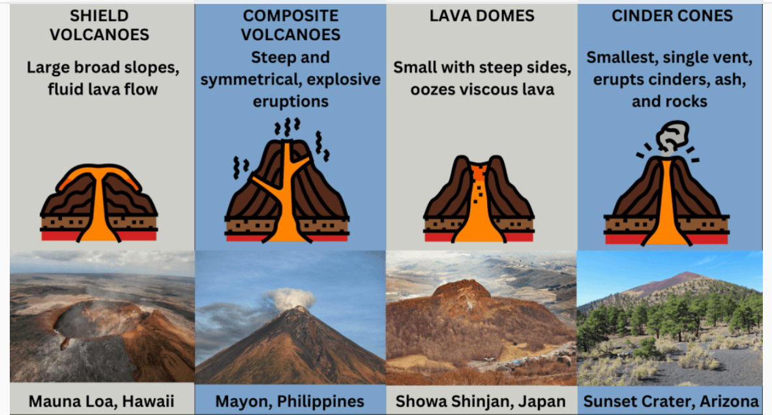
Stratovolcanoes,

Slide 12
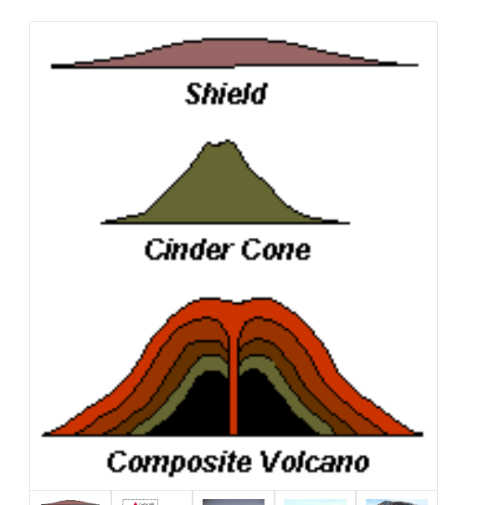
THINK
Could an animal live in a volcano?
https://www.youtube.com/watch?v=5-fGpjJd0wc
https://www.youtube.com/watch?v=3Jxeh-yAXek
Volcano Introduction for kids
https://www.youtube.com/watch?v=VNGUdObDoLk
National Geographics
Stratovolcano

Slide 13
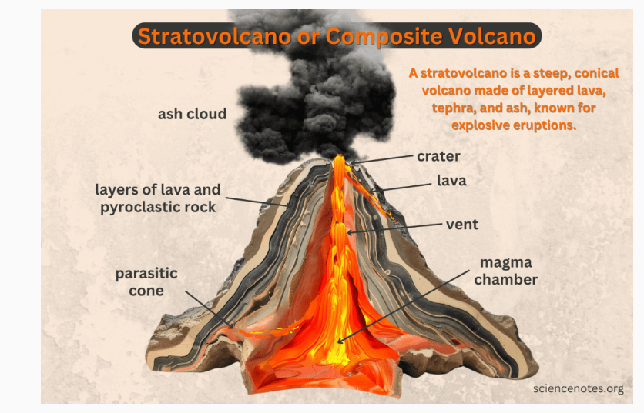
Stratovolcanoes

Slide 14
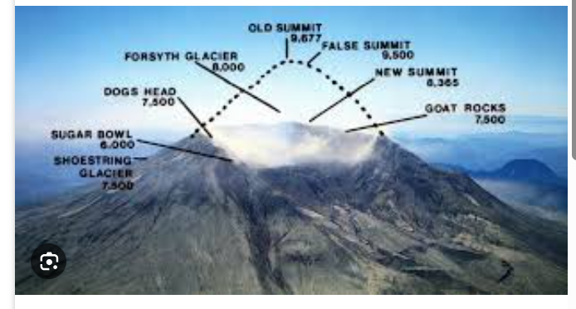
https://www.youtube.com/watch?v=plsO8pxuURk
Mountain of Fire
Composite or Stratovolcanoes are made up of dirt, dust, ash, lava, etc. The have wide steep slopes. An example is Mount St. Helens in Washington. This volcano in Washington State is famous for its catastrophic 1980 eruption, which killed 57 people.

Slide 15
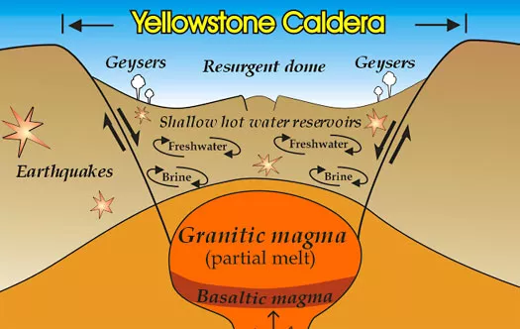
Yellowstone caldera Supervolcano
The caldera at Yellowstone Park is the site of at least 3 great supervolcano eruptions in the past. It is oval shaped depression in the ground 34-miles by 45-miles. The caldera formed when pyroclastic material exploded out of the volcano's partly emptying the magma chamber causing the roof to collapse. When the roof collapsed over the magma chamber it created a bowl shaped depression in the ground.
Scientists estimate the ash and pyroclastic rocks erupted by the volcano was 1000 times greater than the Mount Saint Helens eruption in 1980. Pyroclastic flows, carried enough pyroclastic material to cover 3,000 square miles.
https://www.youtube.com/watch?v=JA7a9nnxNvM What if a Supervolcano Erupted?
https://www.youtube.com/watch?v=_PxDGiVQNg8 Yellowstone Super Volcano
https://www.youtube.com/watch?v=snAHgkjmV5w How the Earth Was Made: Yellowstone | History

Slide 16
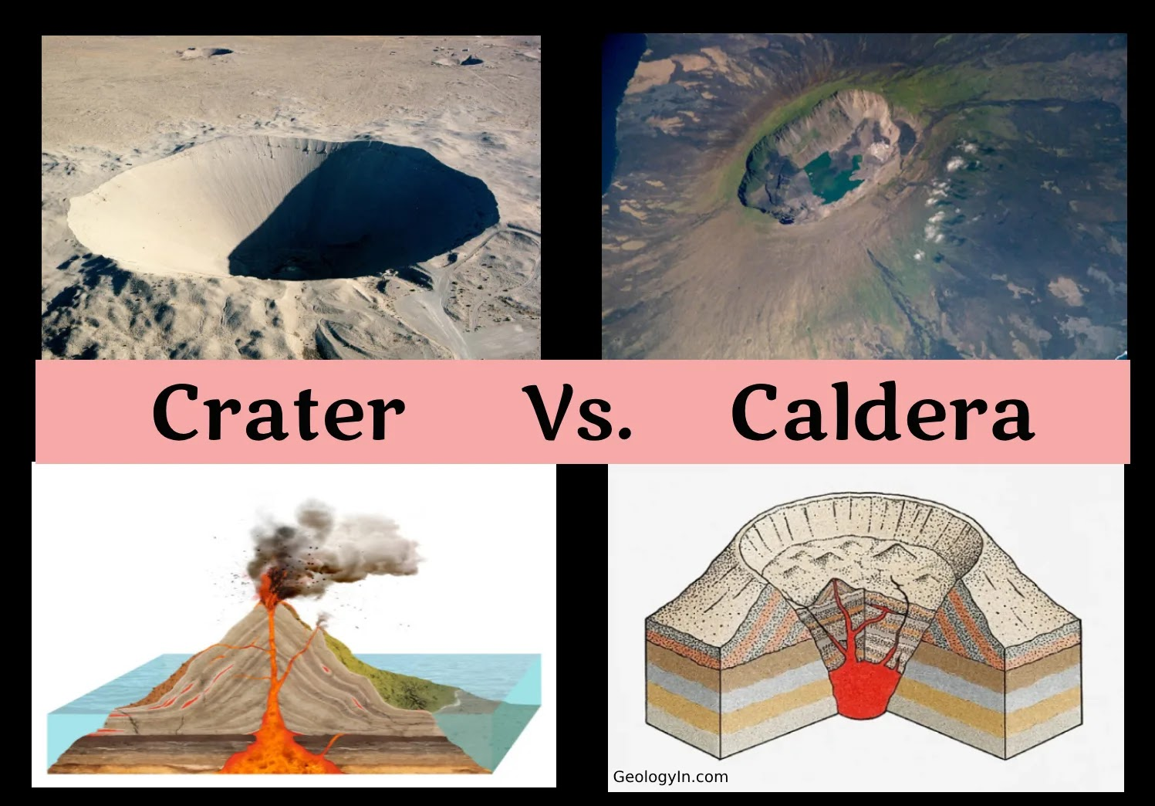
A supervolcano is a volcano that can have an incredibly massive and explosive eruption, called a supereruption, which is so large it's ranked the highest on the Volcanic Explosivity Index (VEI 8). These eruptions blast out more than 240 cubic miles (or 1,000 cubic kilometers) of magma, which is enough to form a giant, circular collapse feature called a caldera.
This is thousands of times bigger than most volcanic eruptions we know about!

Slide 17
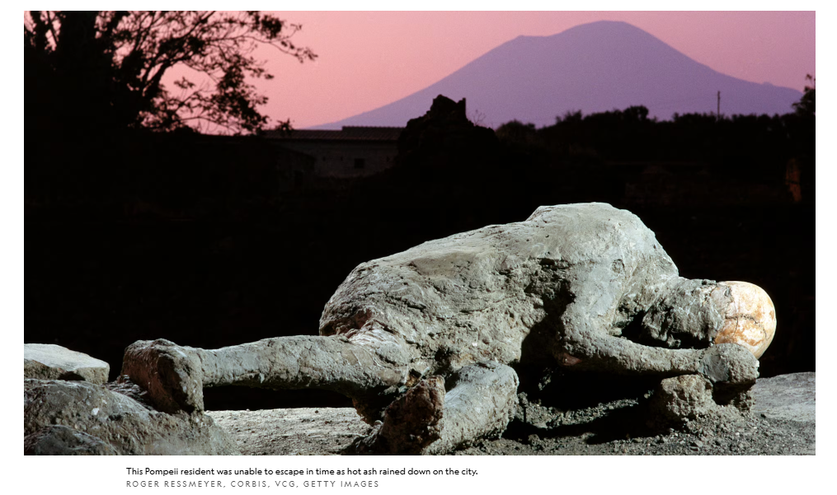
The volcano that erupted near Pompeii, Mount Vesuvius, is a stratovolcano. Its erupted in 79 A.D. After the volcano first erupted shortly after noon, the thick ash turned everything black—people couldn’t even see the sun. Some residents escaped the city, while others took shelter in their homes. But the ash kept falling. Piles grew as deep as nine feet in some places, blocking doorways and caving in roofs.

Slide 18
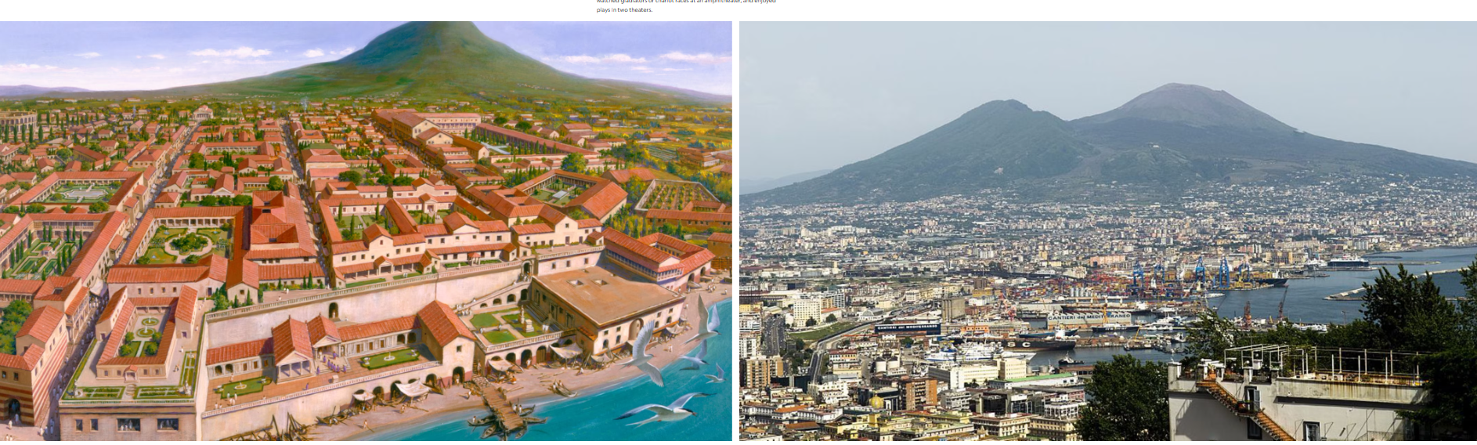
Left: An illustration shows what the cities surrounding Mount Vesuvius might have looked like thousands of years ago.
Louis S. Glanzman, National Geographic Creative
Right: Today more than a million people live in the cities surrounding Mount Vesuvius.
Photograph by INTRO, Rainer Steußloff, ullstein bild, Getty Images
Pompeii may be ancient history, but scientists are pretty sure Mount Vesuvius is overdue for another major explosion. Luckily the people living near the volcano today will likely receive evacuation warnings before it blows.

Slide 19
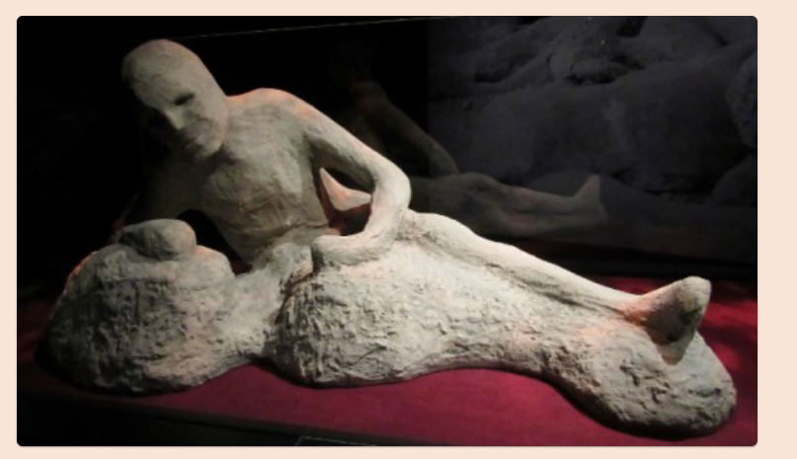
Pompeii wasn't "discovered" by a single person, but its ruins were initially found by accident in 1592 by architect Domenico Fontana while digging a canal, though he didn't realize their importance. The site was then rediscovered and began to be excavated in 1748 by Roque Joaquín de Alcubierre under the King of Naples, with its identity as Pompeii confirmed by an inscription in 1763
Around midnight, the first of four searing-hot clouds of ash, rock, and toxic gas (also called surges) rushed down the volcano. Traveling toward Pompeii at about 180 miles an hour, the surge scorched everything in its path. Around 7 a.m., nearly 19 hours after the initial eruption, the city was completely covered in a deadly mix of ash and rock.
LOST AND FOUND
Visiting the ruins of Pompeii is like going back in time. The layers of ash actually helped preserve buildings, artwork, and even the forms of bodies as they decomposed and left holes in the ash. All that allowed experts to fill in the details that might not have survived at many other Roman sites.
https://www.youtube.com/watch?v=tZ4lAWXLW9g
The Lost City of Pompeii | Mount Vesuvius | Greek History for Kids
https://www.youtube.com/watch?v=YIZ4aSKT3mo
Geography Lesson: Pompeii Volcano Eruption | Twig
https://www.youtube.com/watch?v=faNwHBcX6MQ
When Mount Vesuvius Destroyed an Entire City

Slide 20
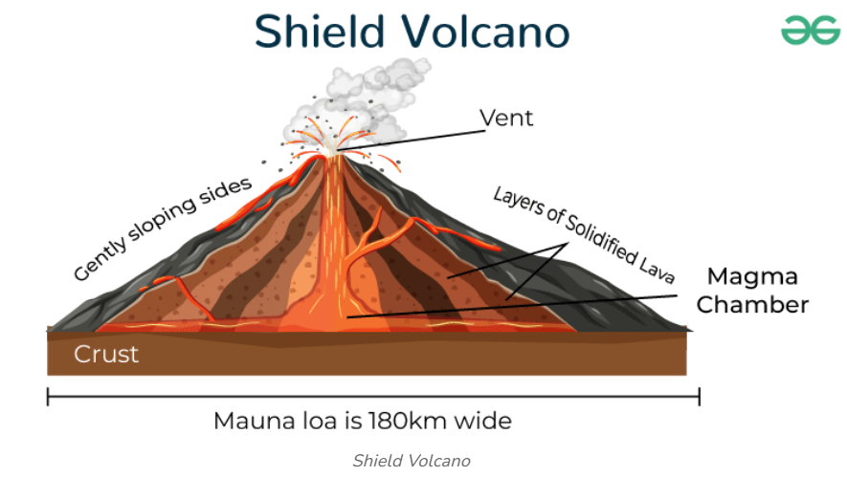
As basalt has a low viscosity (more watery), it can flow on the surface easily. During the eruption of these types of volcanoes, lava flows outwards at large distances.
Eruptions are shorter, and the explosions are not as powerful as stratovolcanoes.

Slide 21
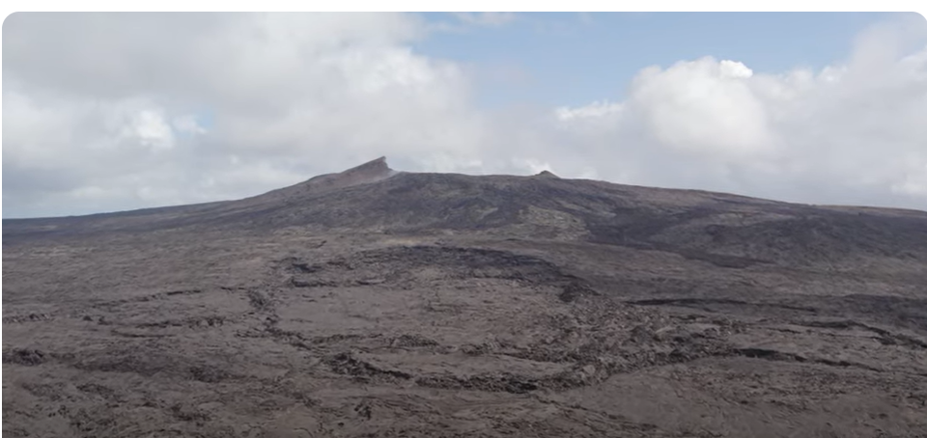
Hawaiian Islands are shield volcanoes -flat and extend for miles. They ooze out lava.
https://www.youtube.com/watch?v=F89Y4mkoY-Q

Slide 22
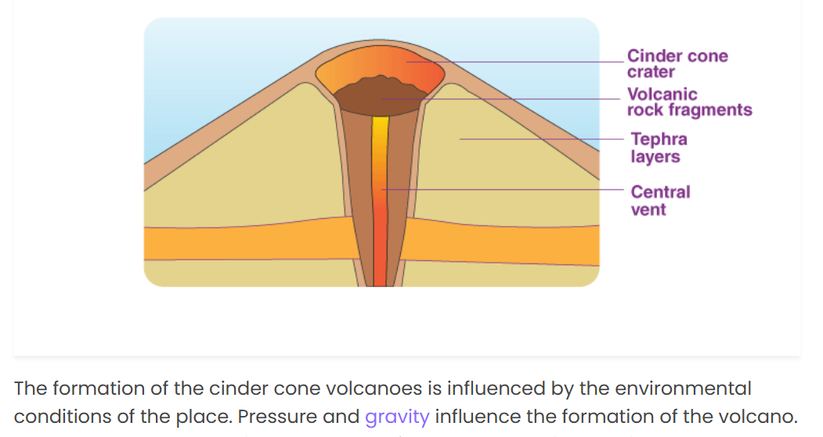
Cinder Cone

Slide 23
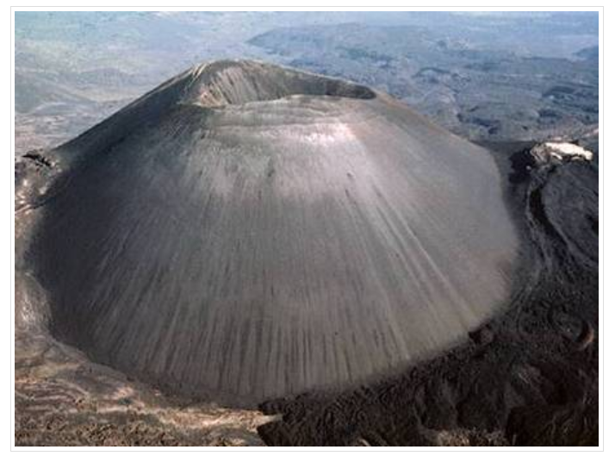
Cinder cone volcanoes are very steep and produce only ash.
They are found in Mexico.
NOTES
Most common
Very explosive
Cinders blow out, harden in air, pile around cone like a gravel pile
Weathers & erodes easily, so usually smaller volcano
No lava to "glue" cinders together
https://www.youtube.com/watch?v=HhYj-siaVvc
The Wonderful World of Cinder Cone Volcanoes Mexico
https://www.youtube.com/watch?v=A_9d2MLClqw
Cinder Cone Volcano - Laasen Volcanic National Park, California

Slide 24
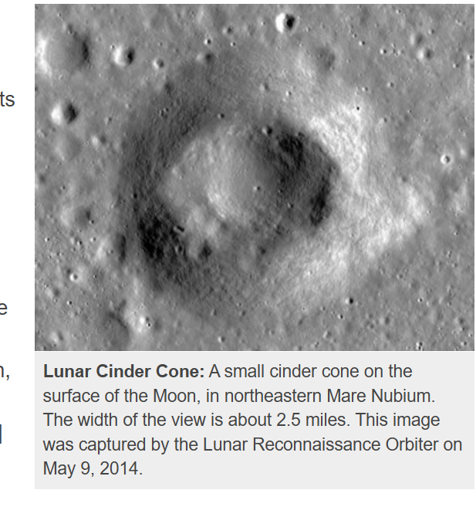

Slide 25
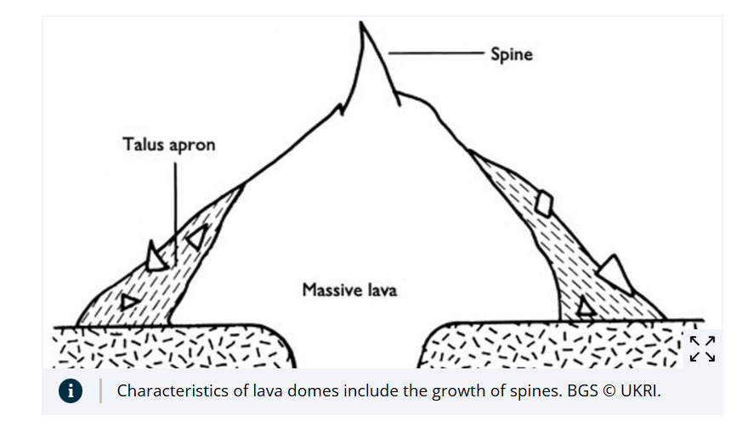
Lava Domes
A lava dome is a round, steep-sided volcano formed by thick, sticky lava that oozes out and piles up around the vent instead of flowing far away. This "glue-like" lava, also called viscous lava, builds up a rounded mound.
Most domes are relatively small volcanoes.

Slide 26
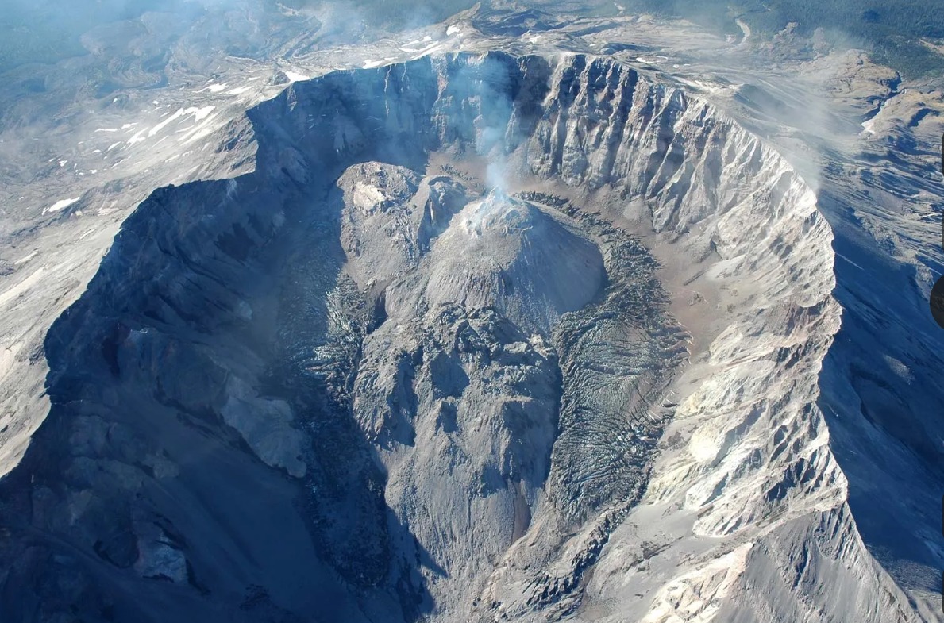

Slide 27
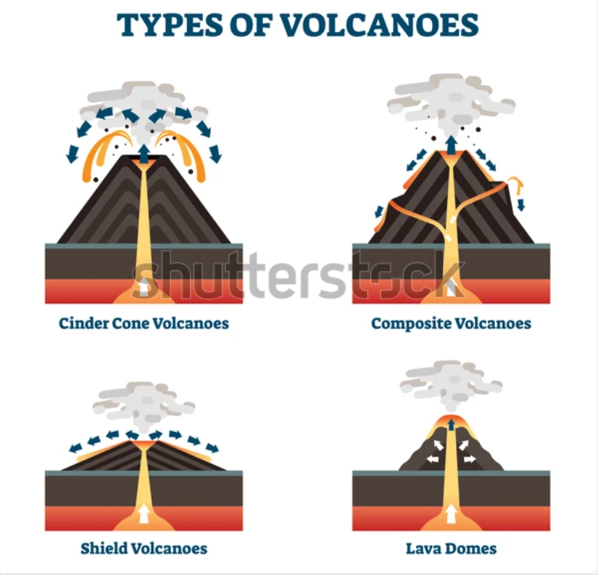

Slide 28
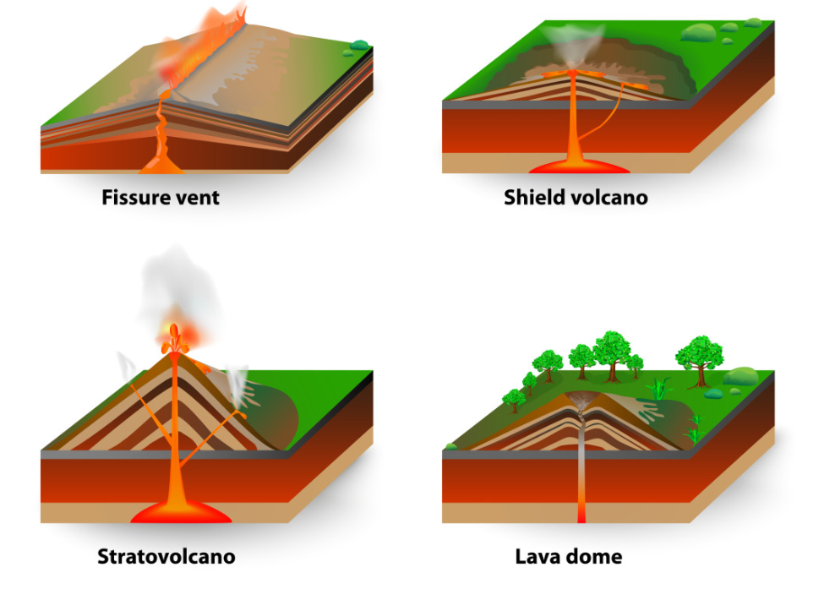
Composit

Slide 29
Active Volcanoes
A volcano that is currently erupting or has erupted in historical time. Kīlauea in Hawaii, Mount Etna in Italy, and Mount Stromboli in Italy.
Dormant Volcanoes
A volcano that is not currently erupting but is expected to do so in the future. These can be "restless" systems with signs of heat and magma activity. Mount Rainier in the U.S. and Mount Kilimanjaro in Tanzania are considered dormant.
Extinct Volcanoes A volcano that is not expected to erupt again. Their magma supply has been cut off due to factors like tectonic plate movement, and they show no signs of volcanic activity. Capulin Volcano in the U.S.

Slide 30
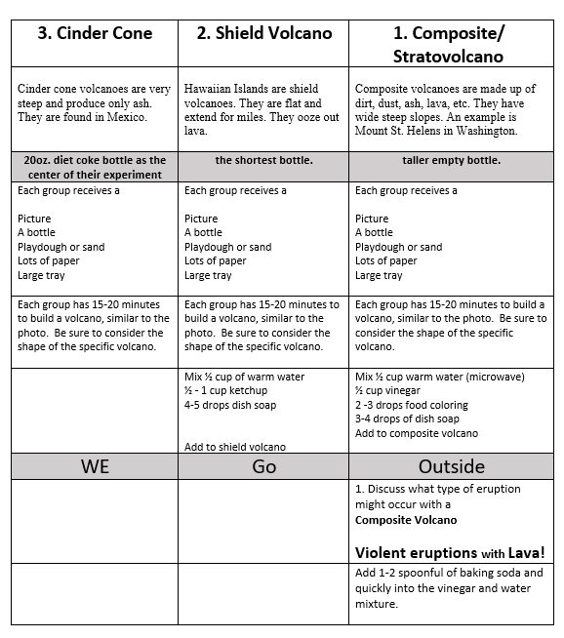
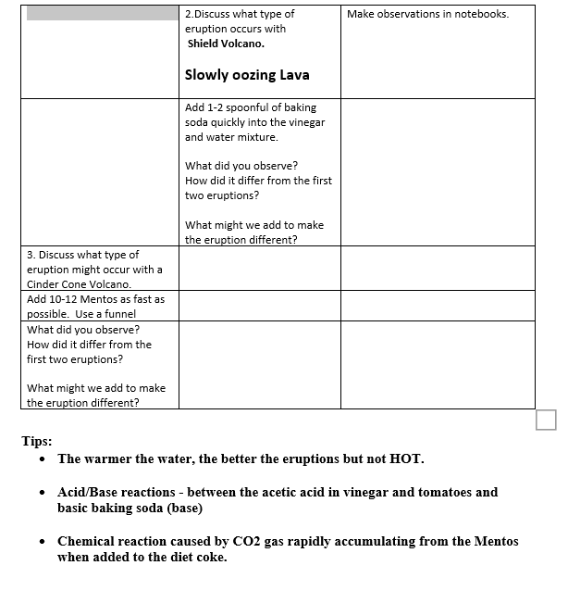
Volcano Experiments: Cinder Cone, Shield, and Stratovolcano/ Composite
Experiments should happen in chronological order

Slide 31
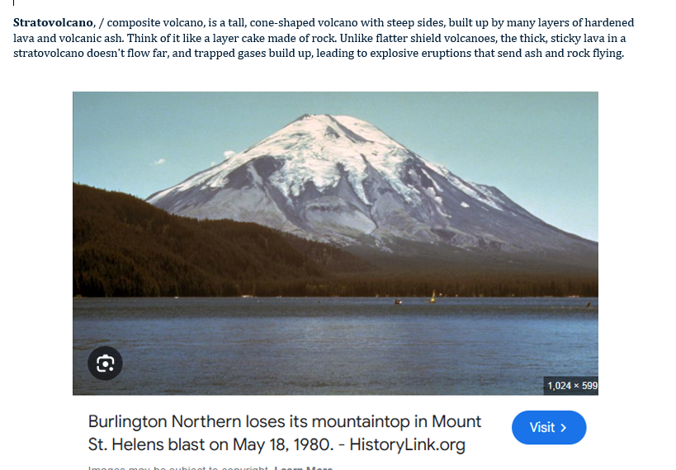

Slide 32
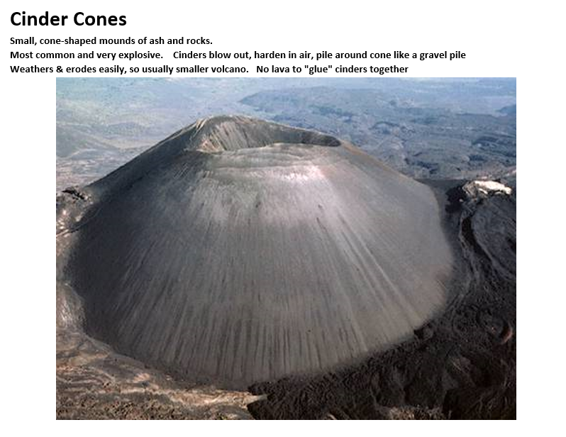

Slide 33
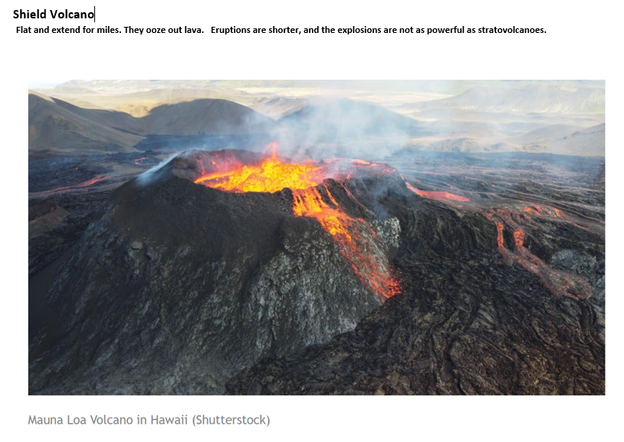

Slide 34

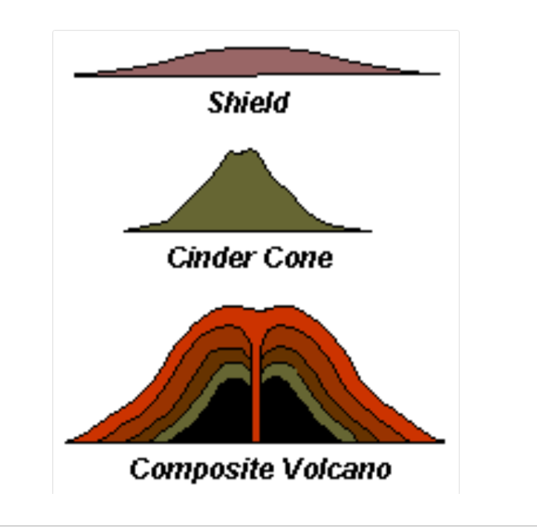

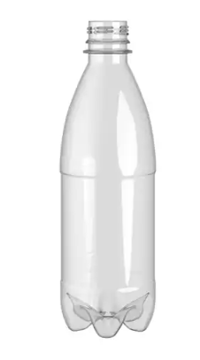
Shorter bottle
Taller
Bottle
Stratovolcano

