Slide 1
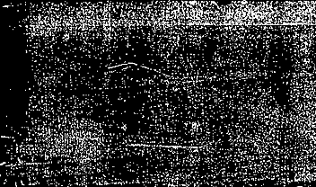
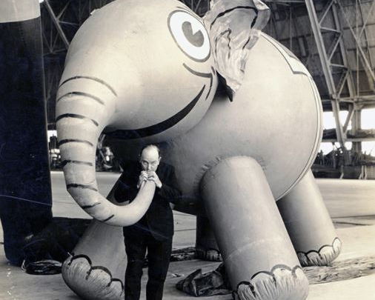

Tony Sarg: Puppeteer of Macy’s Parade

Slide 2
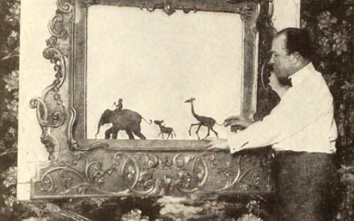
Tony Sarg
Tony Sarg began his career designing puppets and window displays for Macy’s Store.

Slide 3

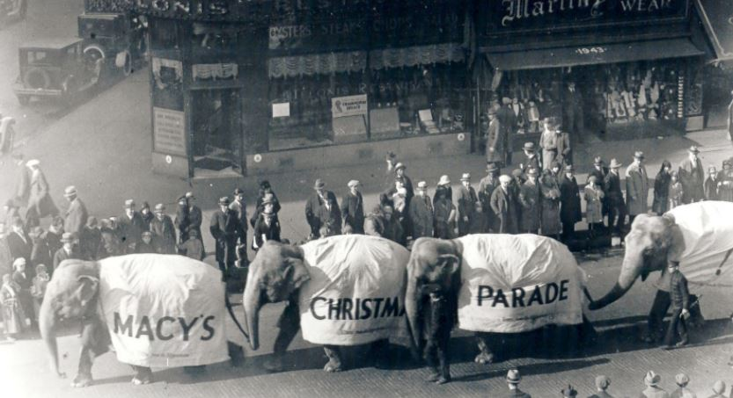

1924
The First Macy’s Parade had no balloons.
They borrowed animals from the zoo.

Slide 4
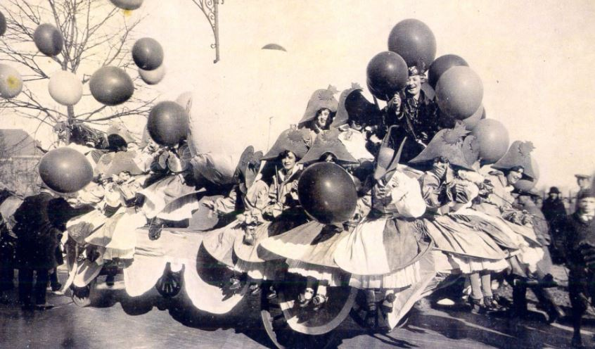
1924
This “Balloonatic” float inspired Tony Sarg to create his first character balloons.

Slide 5
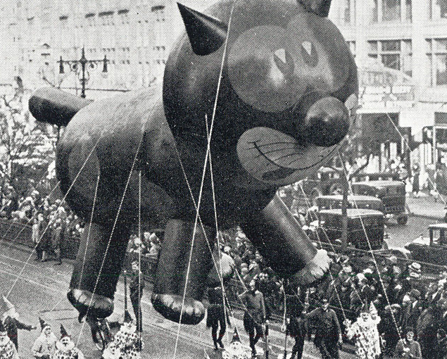
1927
The first balloon created by Tony Sarg was Felix the Cat.

Slide 6
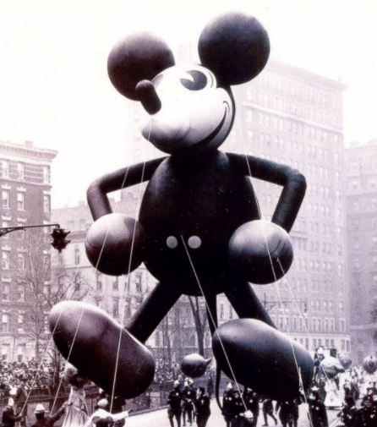
Earliest Balloons
Mickey Mouse was one of the earliest balloons and was designed by Tony Sarg with help from Walt Disney.

Slide 7
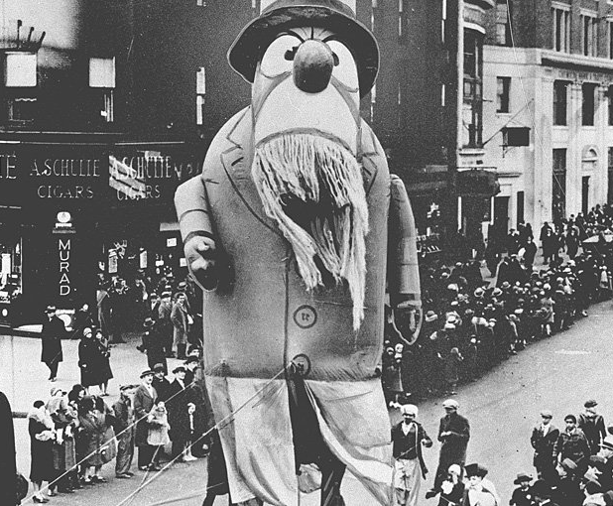
1929
Captain Nemo

Slide 8
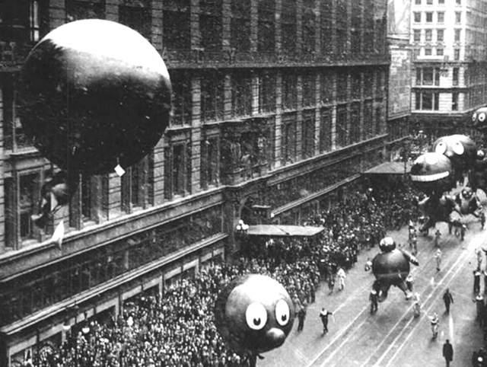
Balloon Release
Macy's used to release the balloons after the parade was over. Tickets were attached with a reward of $100 for the return of the balloons.
In 1931, a balloon became entangled on the wing of an airplane endangering the pilot. After this Macy’s no longer released its balloons.

Slide 9
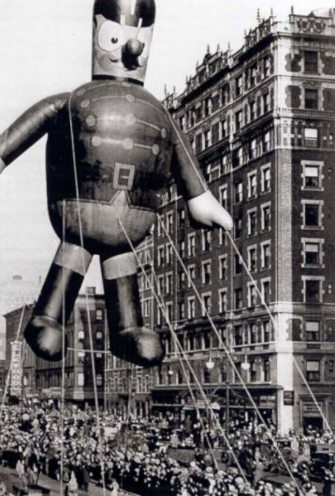
1930’s
A band leader was one of the first balloons added in the 1930’s.

Slide 10
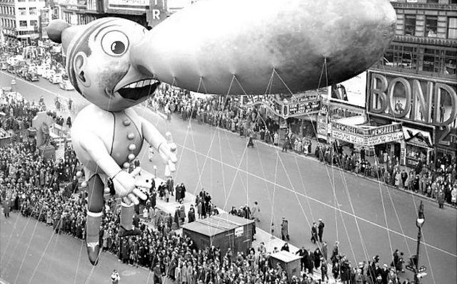
1937
Pinocchio
20 handlers were required to control his nose.

Slide 11
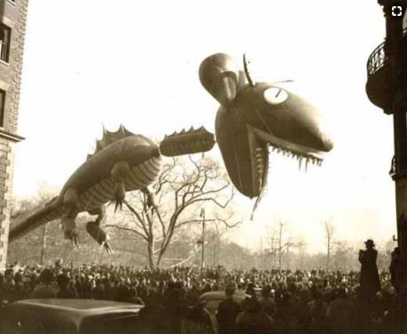
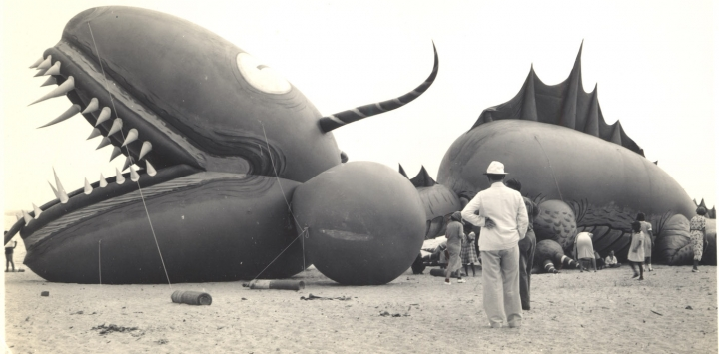
1937
Tony Sarg’s sea serpent balloon

Slide 12
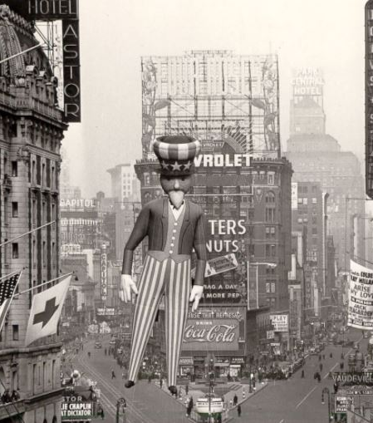
1940’s
Uncle Sam joined the parade in the early 1940’s.
The parade was not held from 1942-1944 because of World War II. The nation was undergoing rubber and helium shortages.

Slide 13
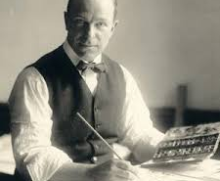
1942
Tony Sarg died in 1942 from complications from a ruptured appendix.
However, the Macys Parade continues to create new and different balloons every year.

Slide 14
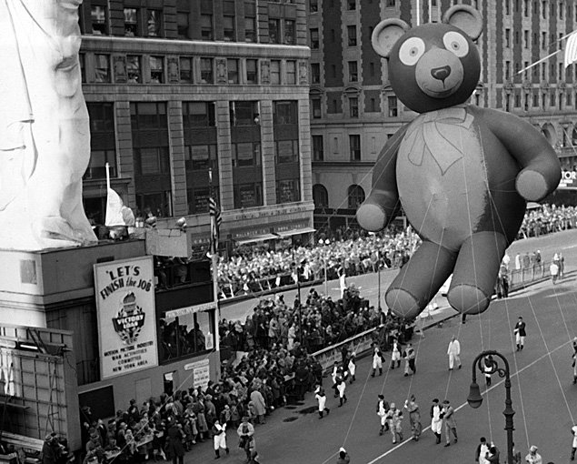
1945
Teddybear

Slide 15
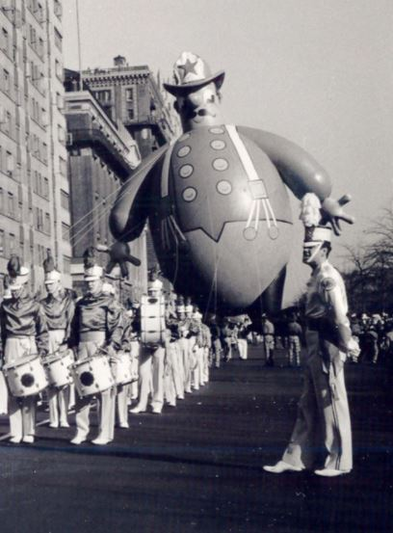
1950’s
Harold the Fireman was added to the parade lineup.
He changed occupations throughout the years. He’s been a baseball player and a police officer.

Slide 16
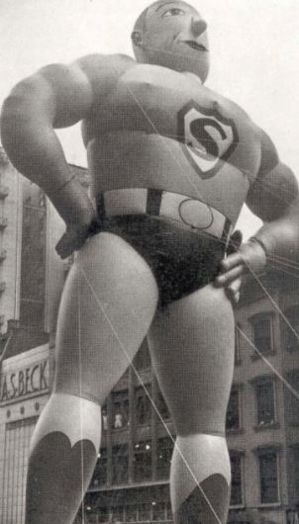
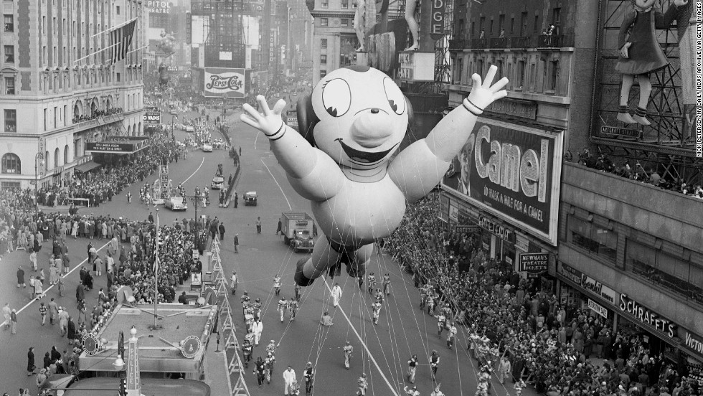
1950’s
Mighty Mouse and Superman

Slide 17
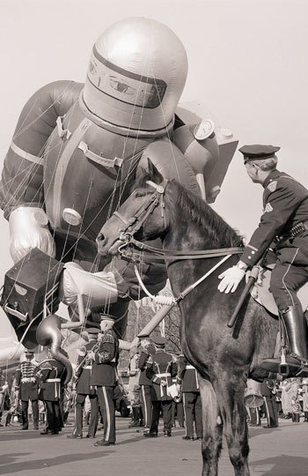
1952
Space Man

Slide 18
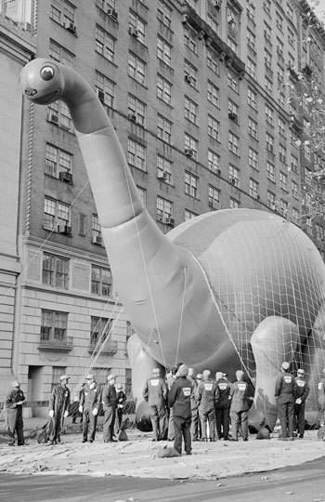
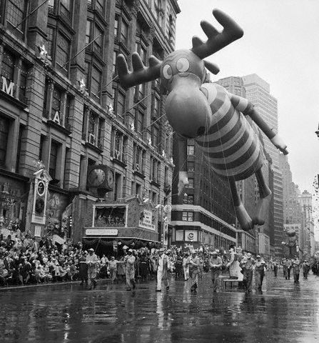
1960’s
Bullwinkle and Sinclair Dinosaur

Slide 19
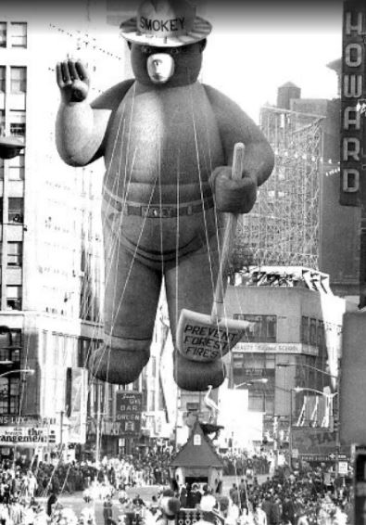
1969
Smokey Bear

Slide 20
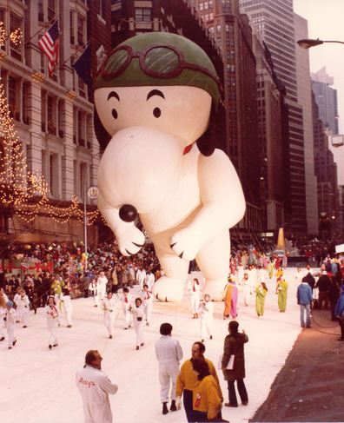
1970’s
The first Snoopy balloon

Slide 21
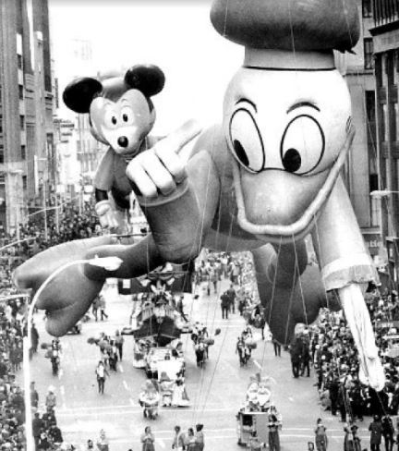
1972
Donald and Mickey
Balloons continue to change throughout the years. Mickey Mouse is revised often.

Slide 22
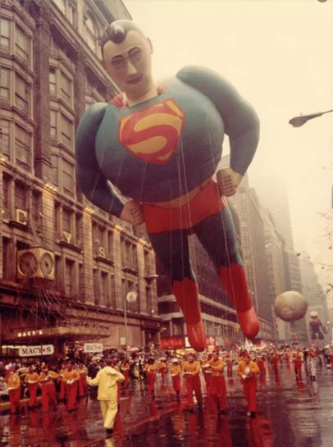
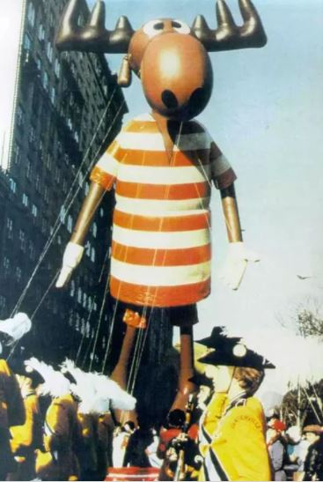
1970’s
Superman
Bullwinkle

Slide 23
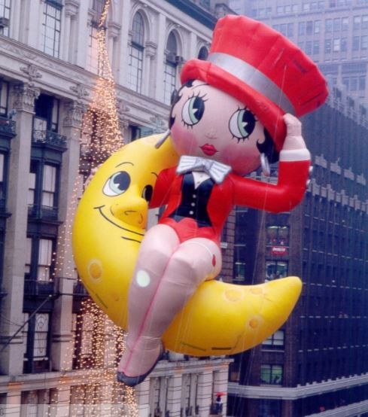
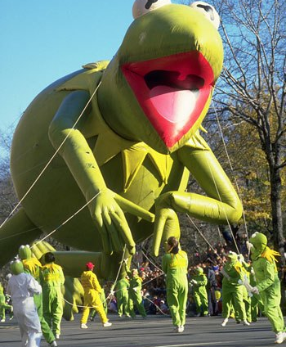
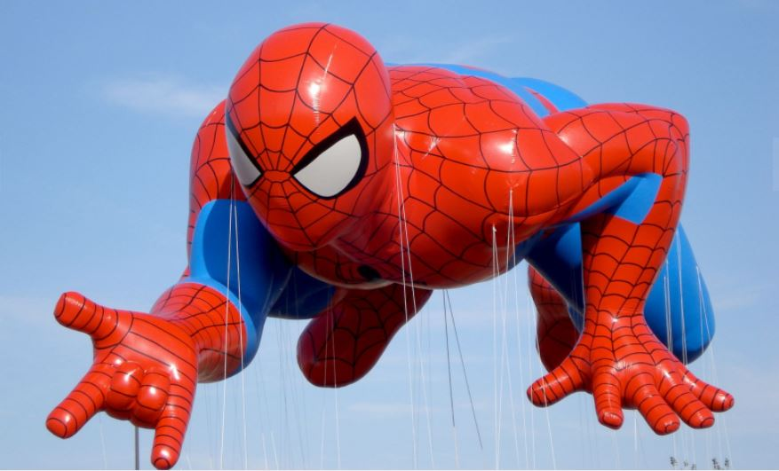
1980’s
Kermit
Betty Boop
Spiderman

Slide 24
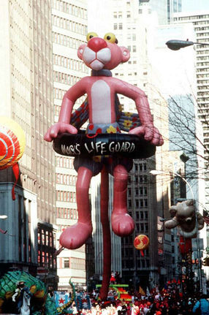
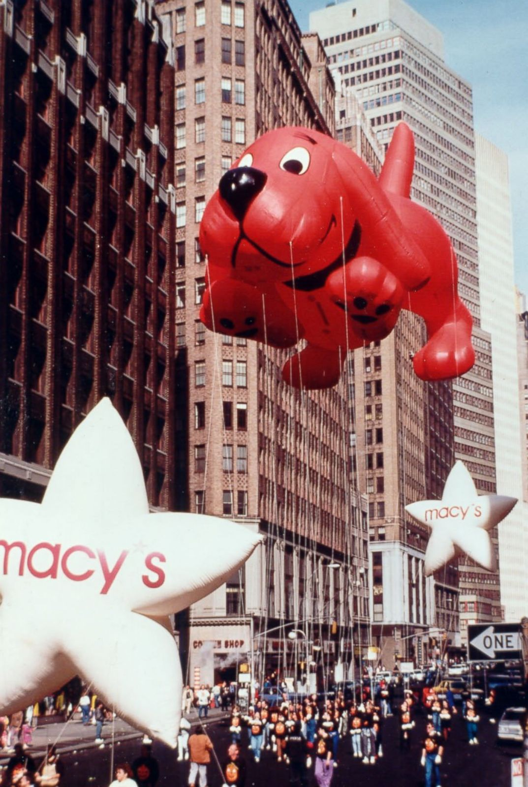
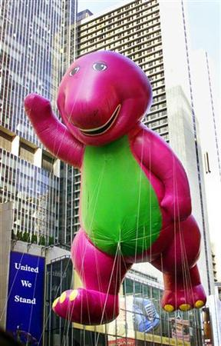
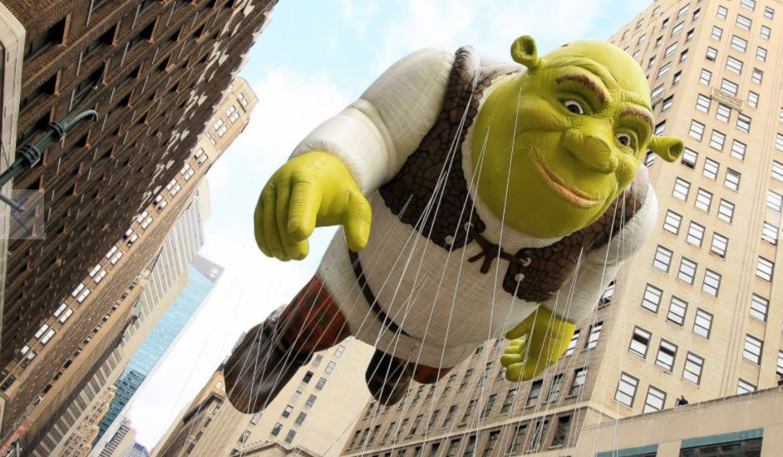
1990’s
Pink Panther
Clifford
Shrek
Barney the Dinosaur

Slide 25
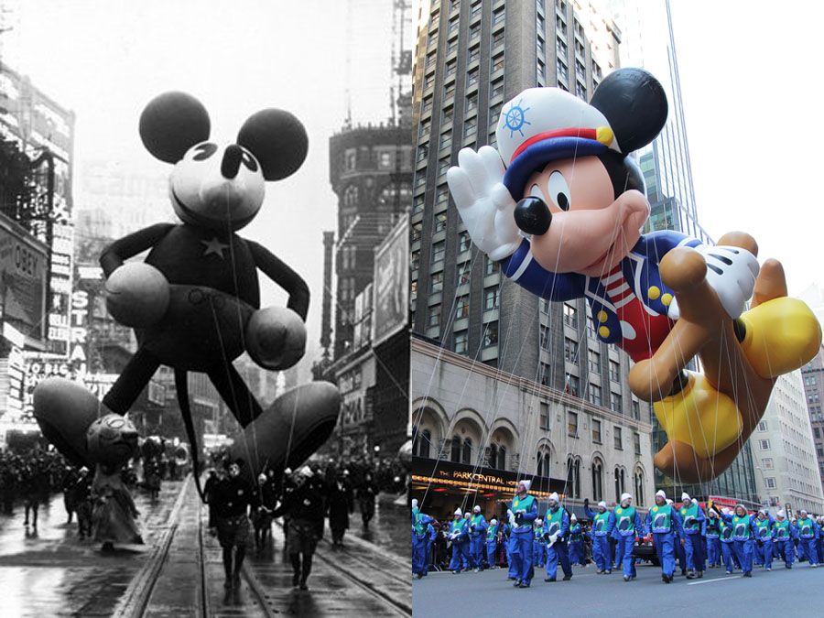
Mickey Mouse: Then and Now
Artists are always updating favorite balloons for the Macy’s Parade.

Slide 26
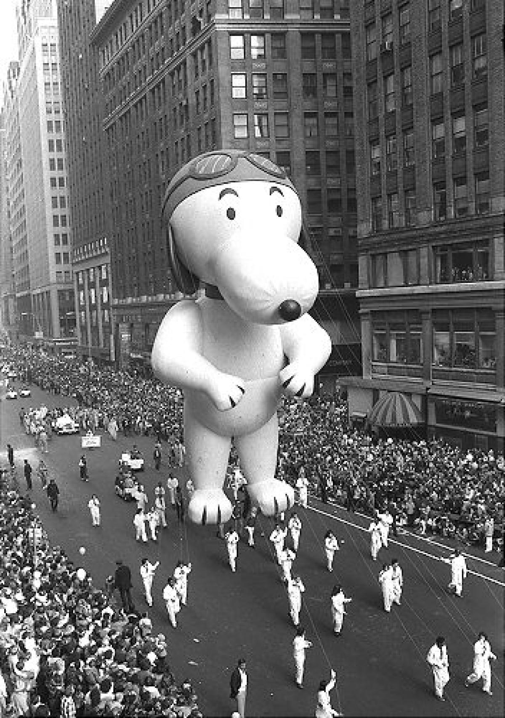
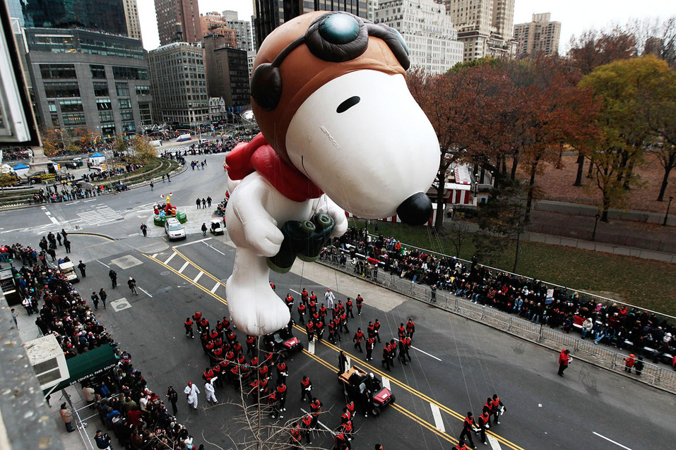
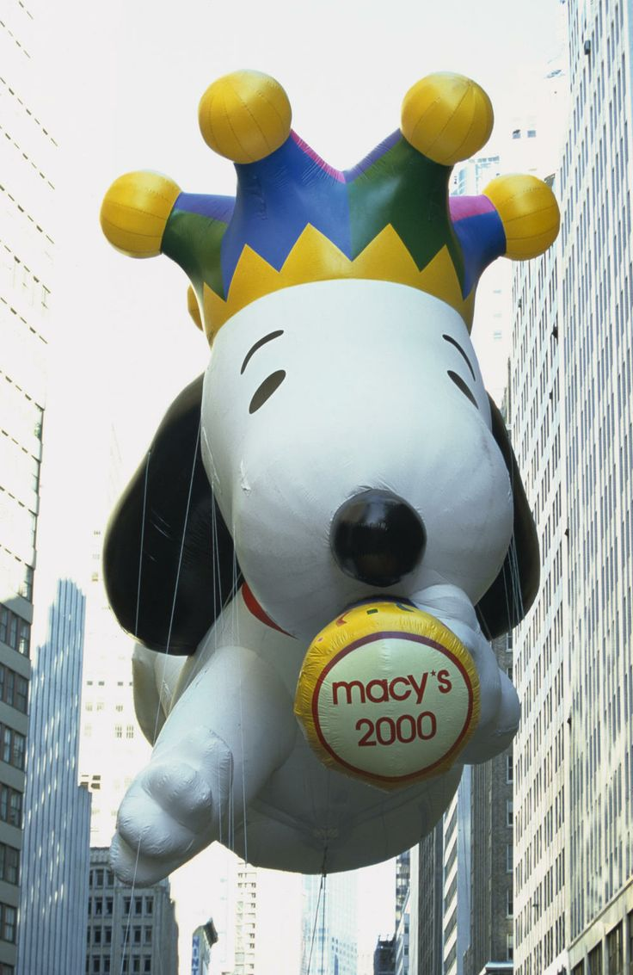
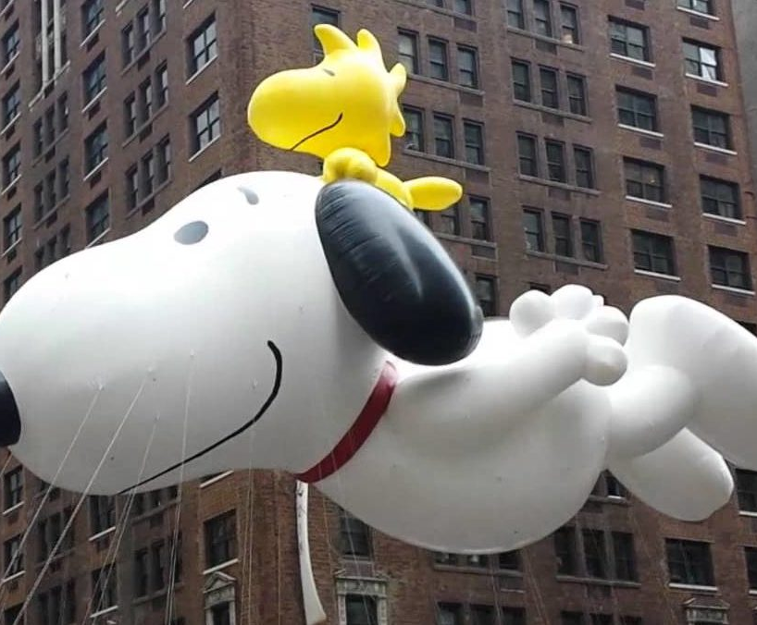
Snoopy
The Snoopy balloon has changed several times throughout the years.

Slide 27
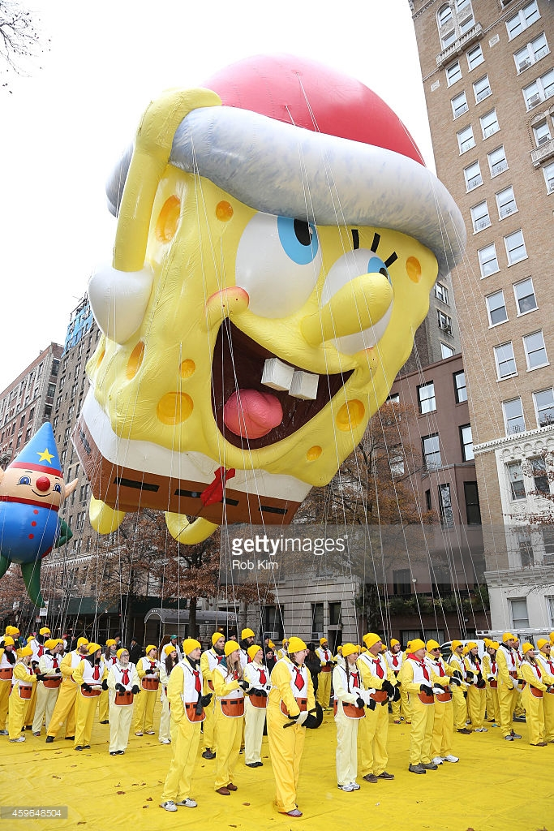
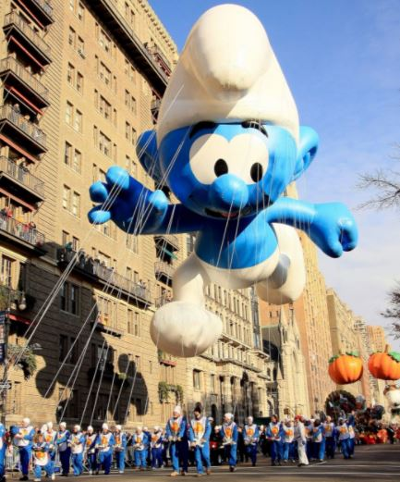
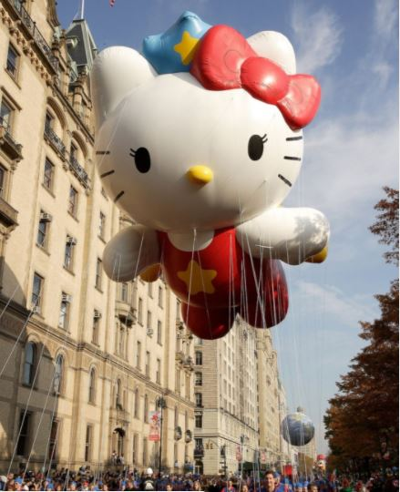
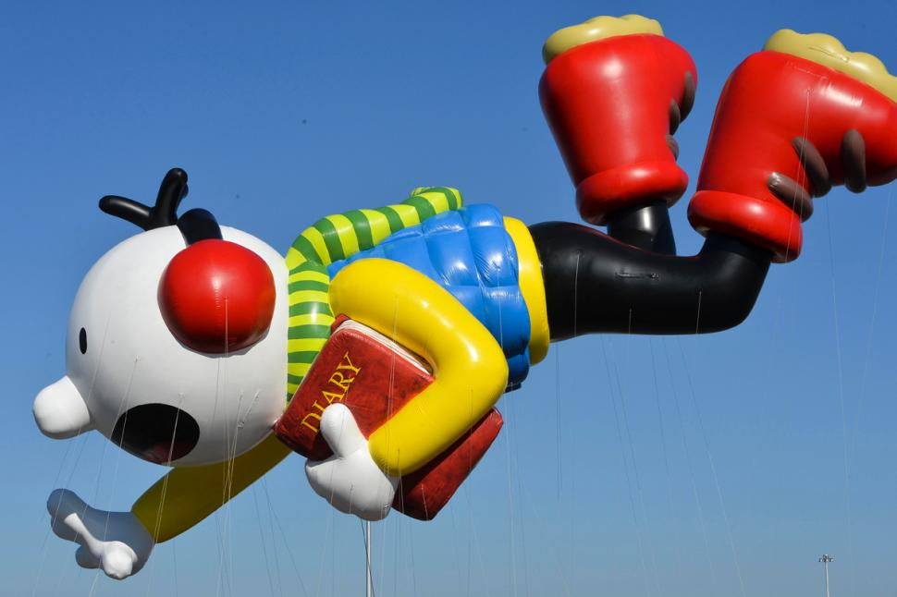
Current Favorites
Spongebob
Smurf
Hello Kitty
Wimpy Kid
Watch for these balloons and new ones in this year’s Macy’s Thanksgiving Parade!

Slide 28
Sources
http://abcnews.go.com/US/photos/macys-thanksgiving-day-parade-years-9150043/image-27003168
https://people.howstuffworks.com/culture-traditions/holidays-other/macys-thanksgiving-day-parade1.htm
http://www.cnn.com/2013/11/24/us/new-york-macys-thanksgiving-parade/index.html
https://hyperallergic.com/339488/tony-sarg-macys-thanksgiving-parade/
http://www.nydailynews.com/new-york/macy-balloons-years-gallery-1.13136?pmSlide=1.25731
http://macysthanksgiving.wikia.com/wiki/The_Pink_Panther

