Slide 1
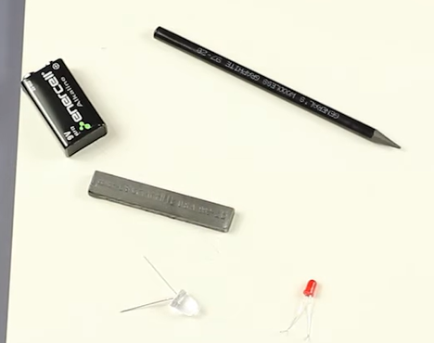
Materials Needed

Slide 2
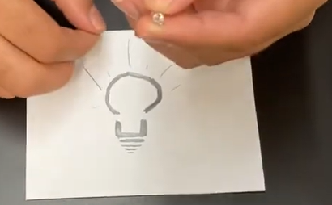
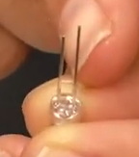
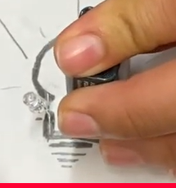
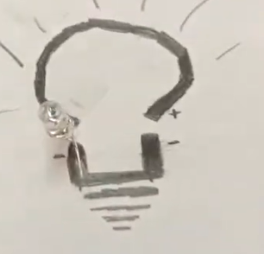
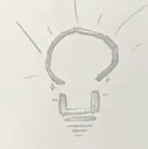
https://www.youtube.com/watch?v=od-vv8H4Oe8
Positive to Positive
Negative to Negative of the LED and pathway from Power source
The longer leg is POSITIVE
LED
Light Emitting Diode
Notice where the positive and negatives points are located. Mark them on your drawing
Place positive on positive and negative to negative

Slide 3
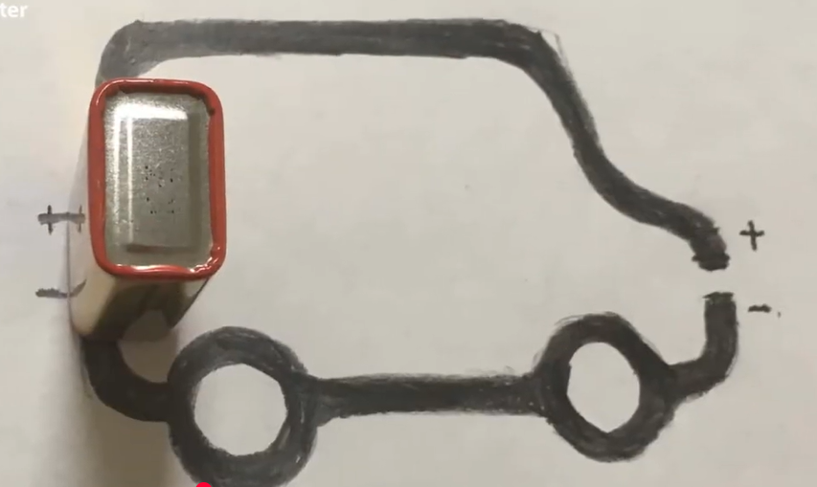

Slide 4
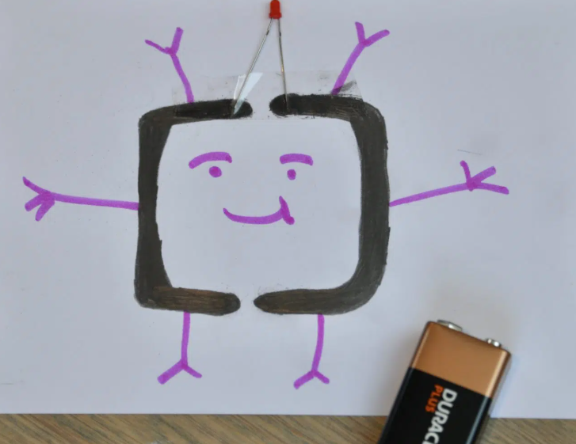
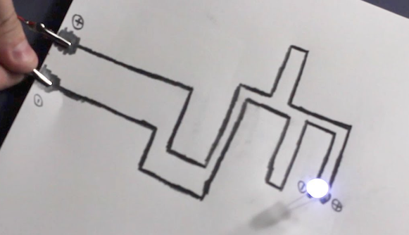
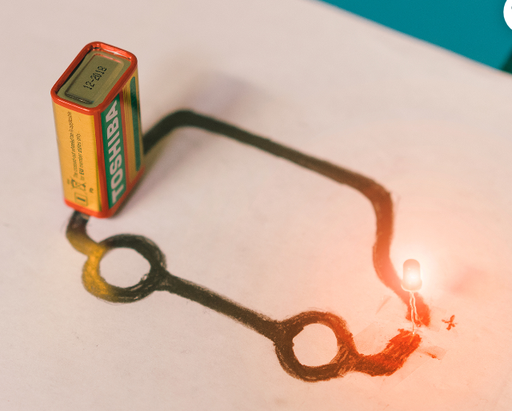
https://www.youtube.com/watch?v=BwKQ9Idq9FM
Paper Circuit!

