Slide 1
2024 - 2025 MCSD Science Olympics
Hardaway High School
Saturday, February 22, 2025
8:00 - 1:30ish

Slide 2
November 11
Gummie bear challenge – Alena, Perla, Catie Jo Give you the supplies
Mystery Architecture – Josiah/ Alena Perla/ Zahara

Slide 3
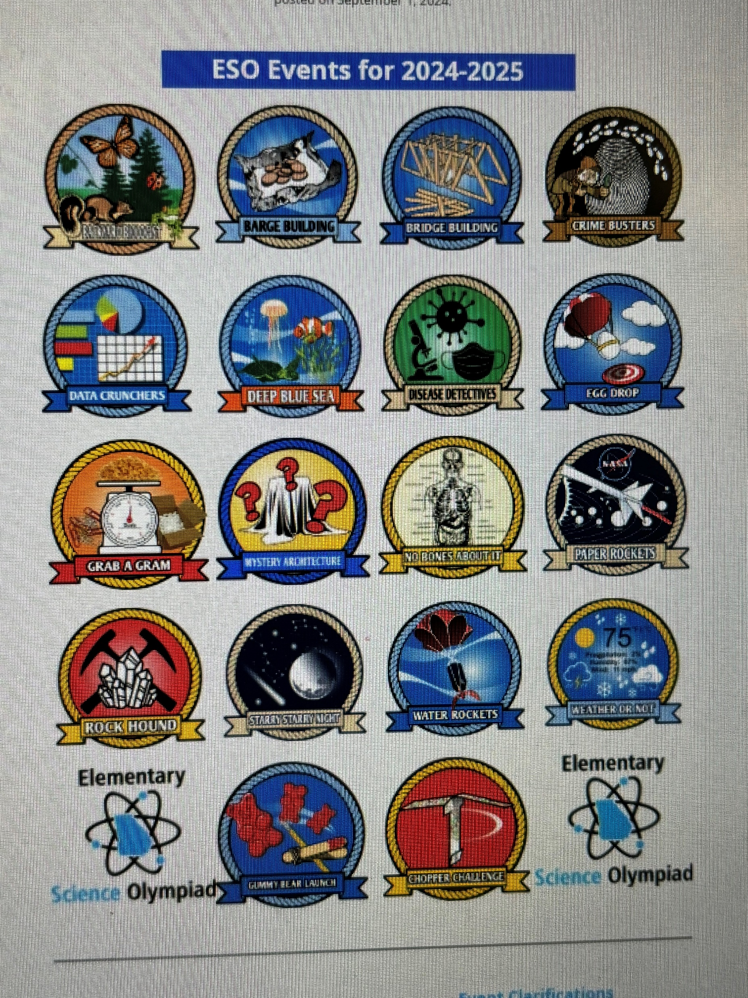
Wynnton Arts Academy Science Olympics Team 2026
Mason
Ben Vickery )5)
Karter Watson (5)
Tyler Williams (5)
Zahara
Perla
Skylar Snow, (4)
Olivia Kemp (4)
Summer (4)
Cate Joe Vickery (3)

Slide 4
Wynnton Arts Academy Science Olympics Team 2025
Alison Thorton (5)
Kayla W (5)
LaDarius (5)
Charisma (5)
Delaney (5)
Quincy (5)
Mason Young (5)
Kayla Kemp (5)
Karter Watson (4)
Jayce Taylor (4)
Tyler Williams (4)
Skylar Snow, (3)
Olivia Kemp (3)

Slide 5
1.Backyard Biologists
2. Barge Building
3. Bridge Building
4. Chopper Challenge NEW for 2025
5. Crime Busters
6. Data Crunchers
7. Deep Blue Sea
8. Disease Detectives
9. Egg Drop
10. Grab a Gram
11. Gummy Bear Launch NEW for 2025
12. Mystery Architecture
13. No Bones About It
14. Paper Rockets
15. Rock Hound
16.
17. Water Rockets
18. Weather or Not
Visit www.georgiascienceteacher.org/gaeso
.
Starry Starry Night

Slide 6
Georgia unique events are:
    Backyard Biologists
    Bridge Building
    Data Crunchers
    Egg Drop
    Gummy Bear Launch

Slide 7
Backyard Biologists
Materials:
Each team may bring up to 2 commercially produced field guides and/or 2 – 3-ring binders with pages in any form from any source. (This means 2 guides, or 2 binders or a guide and a binder.) No Actual specimens –plant or animal - are allowed in the
Teams may also bring up to two hand lenses.
The Competition:
This event will be run as stations that the students rotate through. Stations may include but are not limited to drawings, scenarios, leaves, photographs, specimens, and songs.
Plants and Horticulture
  Identify plant structure such as leaves, bark, fruit, flower, native range, and
  Concepts of gravitropism, phototropism, thigmotropism and
  Basic soil properties (texture and capacity to hold water) and components (sand, clay and humus).
Wildlife
  Basic characteristics and description of habitat
  Eating habits and life cycles
  Importance to the ecosystem and impact on humans or human activities
  Identify calls, songs, tracks, pelts, skulls, and other identifying factors
Scoring:
The score will be based on the following:
Points awarded for the accuracy of responses. Students are not required to provide scientific names of specimens. Common names are appropriate. Ties will be broken by responses to pre-selected questions chosen by the event

Slide 8
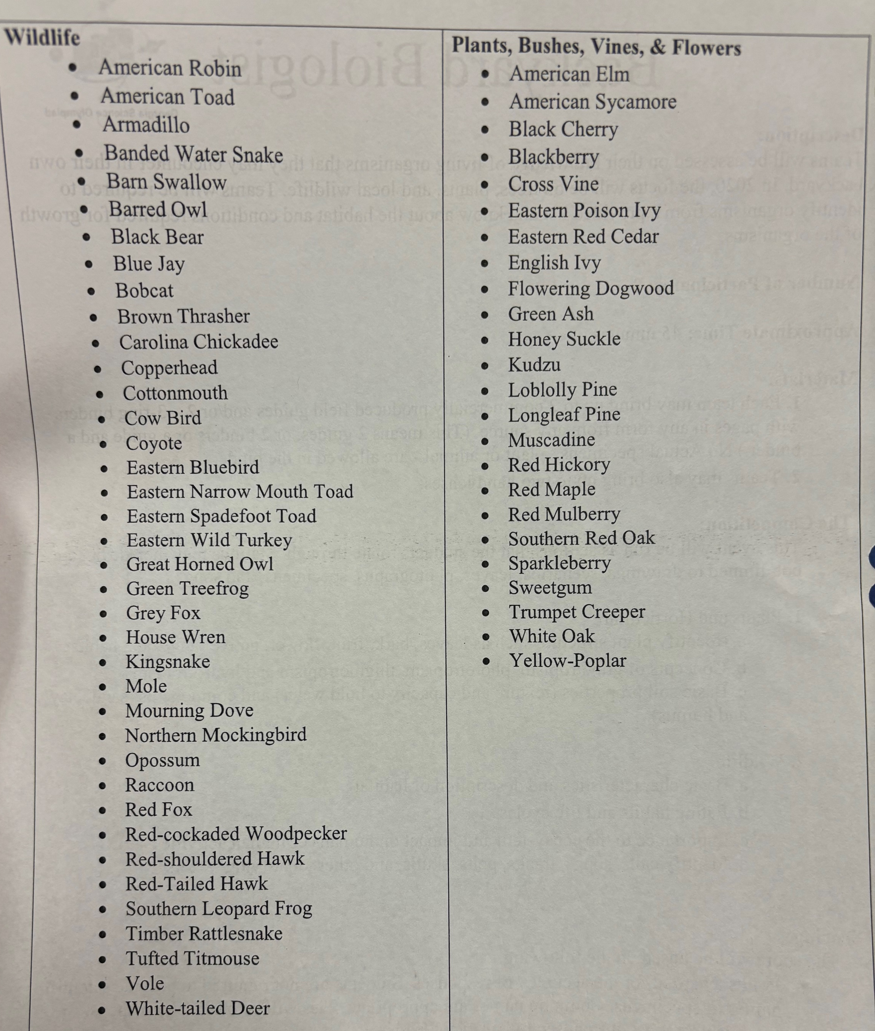
Backyard Biologist
Learn how to recognize these terms
Don’t buy a guide, have students make a guide form animals and plants listed on canvas page. They will need to identify each, possible specimens, leaves, fur, shelters, etc.
- Mr. Ben Travers

Slide 9
https://www.youtube.com/watch?v=9JJslze8MKc
Barge Building
Description: The students will construct a barge using aluminum foil that can support the largest number of objects without sinking.
Team Members: 2 students
The Rules:
Each team will be giving a 15cm X 15cm (6in X 6in) piece of aluminum foil.They will have 15 minutes to construct the barge, no other materials can be used other than the foil.
The students will be informed of the type of cargo (pennies, washers, paper clips, marbles or other similar objects) they will predict how many of that object that their barge can hold.
They will then have 5 minutes to load their barge, one object at a time, until the barge begins to sink. The object that causes the barge to sink will not count in the total.
Scoring:
The score will be determined by the amount of cargo held X 10 minus the difference between predicted amount and actual amount.
Example: Team 1 predicted their barge would hold 47 pennies. Their barge held 53 pennies. Their score would be (53 X 10) - (53-47) = 530 - 6 = 524. If a team intentionally sinks their barge at or near their predicted score, they will be disqualified.
PRACTICE IDEAS:
Have students build a barge from aluminum foil. Give a varity of objects and see how many they can float. The key to this event is how many can it hold, but also predicting. See equation above.

Slide 10
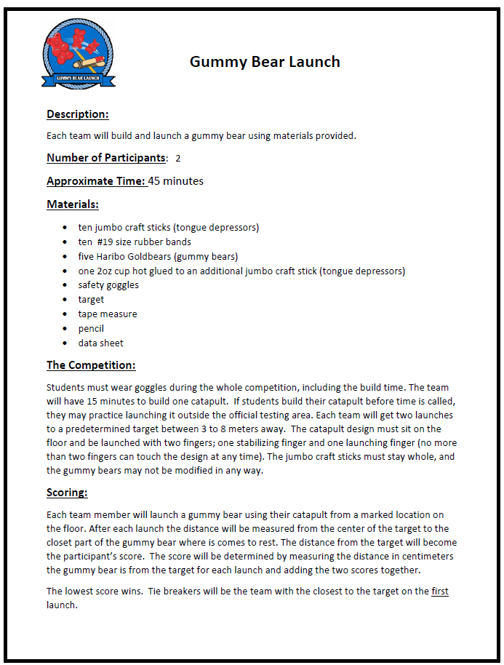
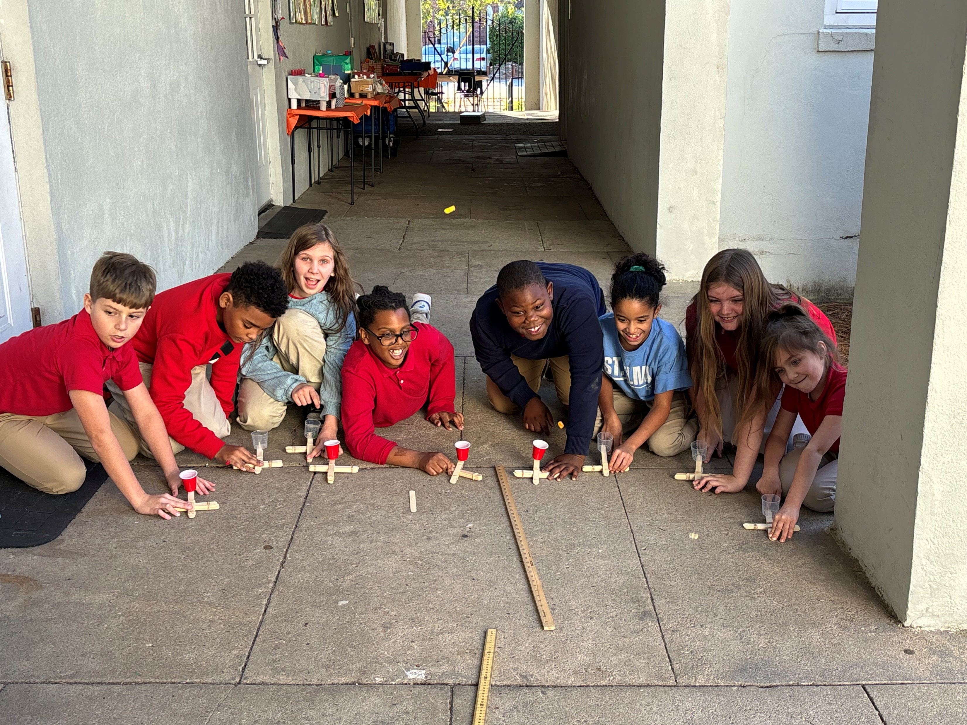
Gummy Bear Launch NEW for 2025
https://www.youtube.com/watch?v=SNhq5EUgsxY

Slide 12
Description:
This event tests a student’s ability to build a lengthy, strong, stable, and
reproducible from common materials.
Team Members: 2 students
The Rules:
1. Students will be given fifty popsicle sticks (4 ½ in x ¼ in size – NOT
JUMBO/Tongue Depressor size) and a meter of making tape. They are to
construct a bridge that spans the greatest possible distance and be able to
support a clay mass, or similar object, of varying weights on the bridge. Students will place the clay mass. or other object on the bridge. Then the students will continue to add weight to determine maximum amount to hold.
2. The bridge must support the clay mass, or object for 10 seconds. Students will be
able to move supports apart to increase the span of the bridge in order to declare a winner if a tie occurs.
3. No string or other materials may be used.
4. The bridge must be suspended on two similar supporting structures—like
two chairs or tables.
5. No popsicle sticks may touch the floor or other supporting structures.
6. Popsicle sticks may be broken and taped together
7. The clay mass will be placed in the middle of the bridge.
Scoring:
1. The bridge spanning the greatest distance supporting the clay mass for 10
seconds will be declared the winner.
2. Time to build the bridge will be used as a tie-breaker.
PRACTICE IDEAS:
-Give students popsicle sticks, tape, and build a bridge, They need to determine how to attach and best structure to hold different amounts of weight.
Bridge Building

Slide 13
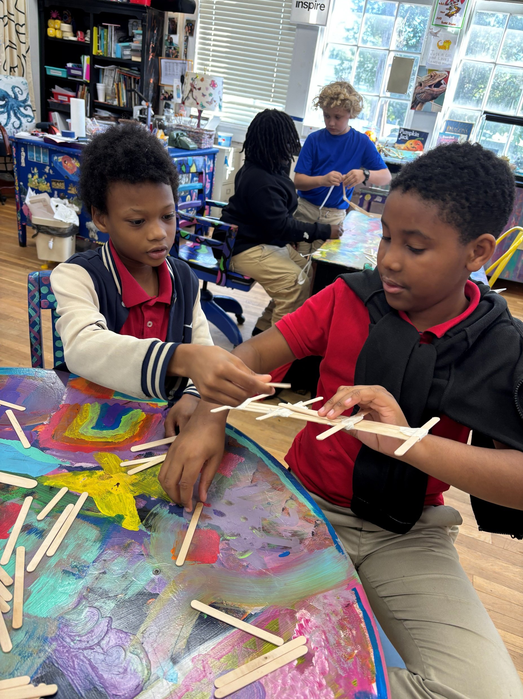
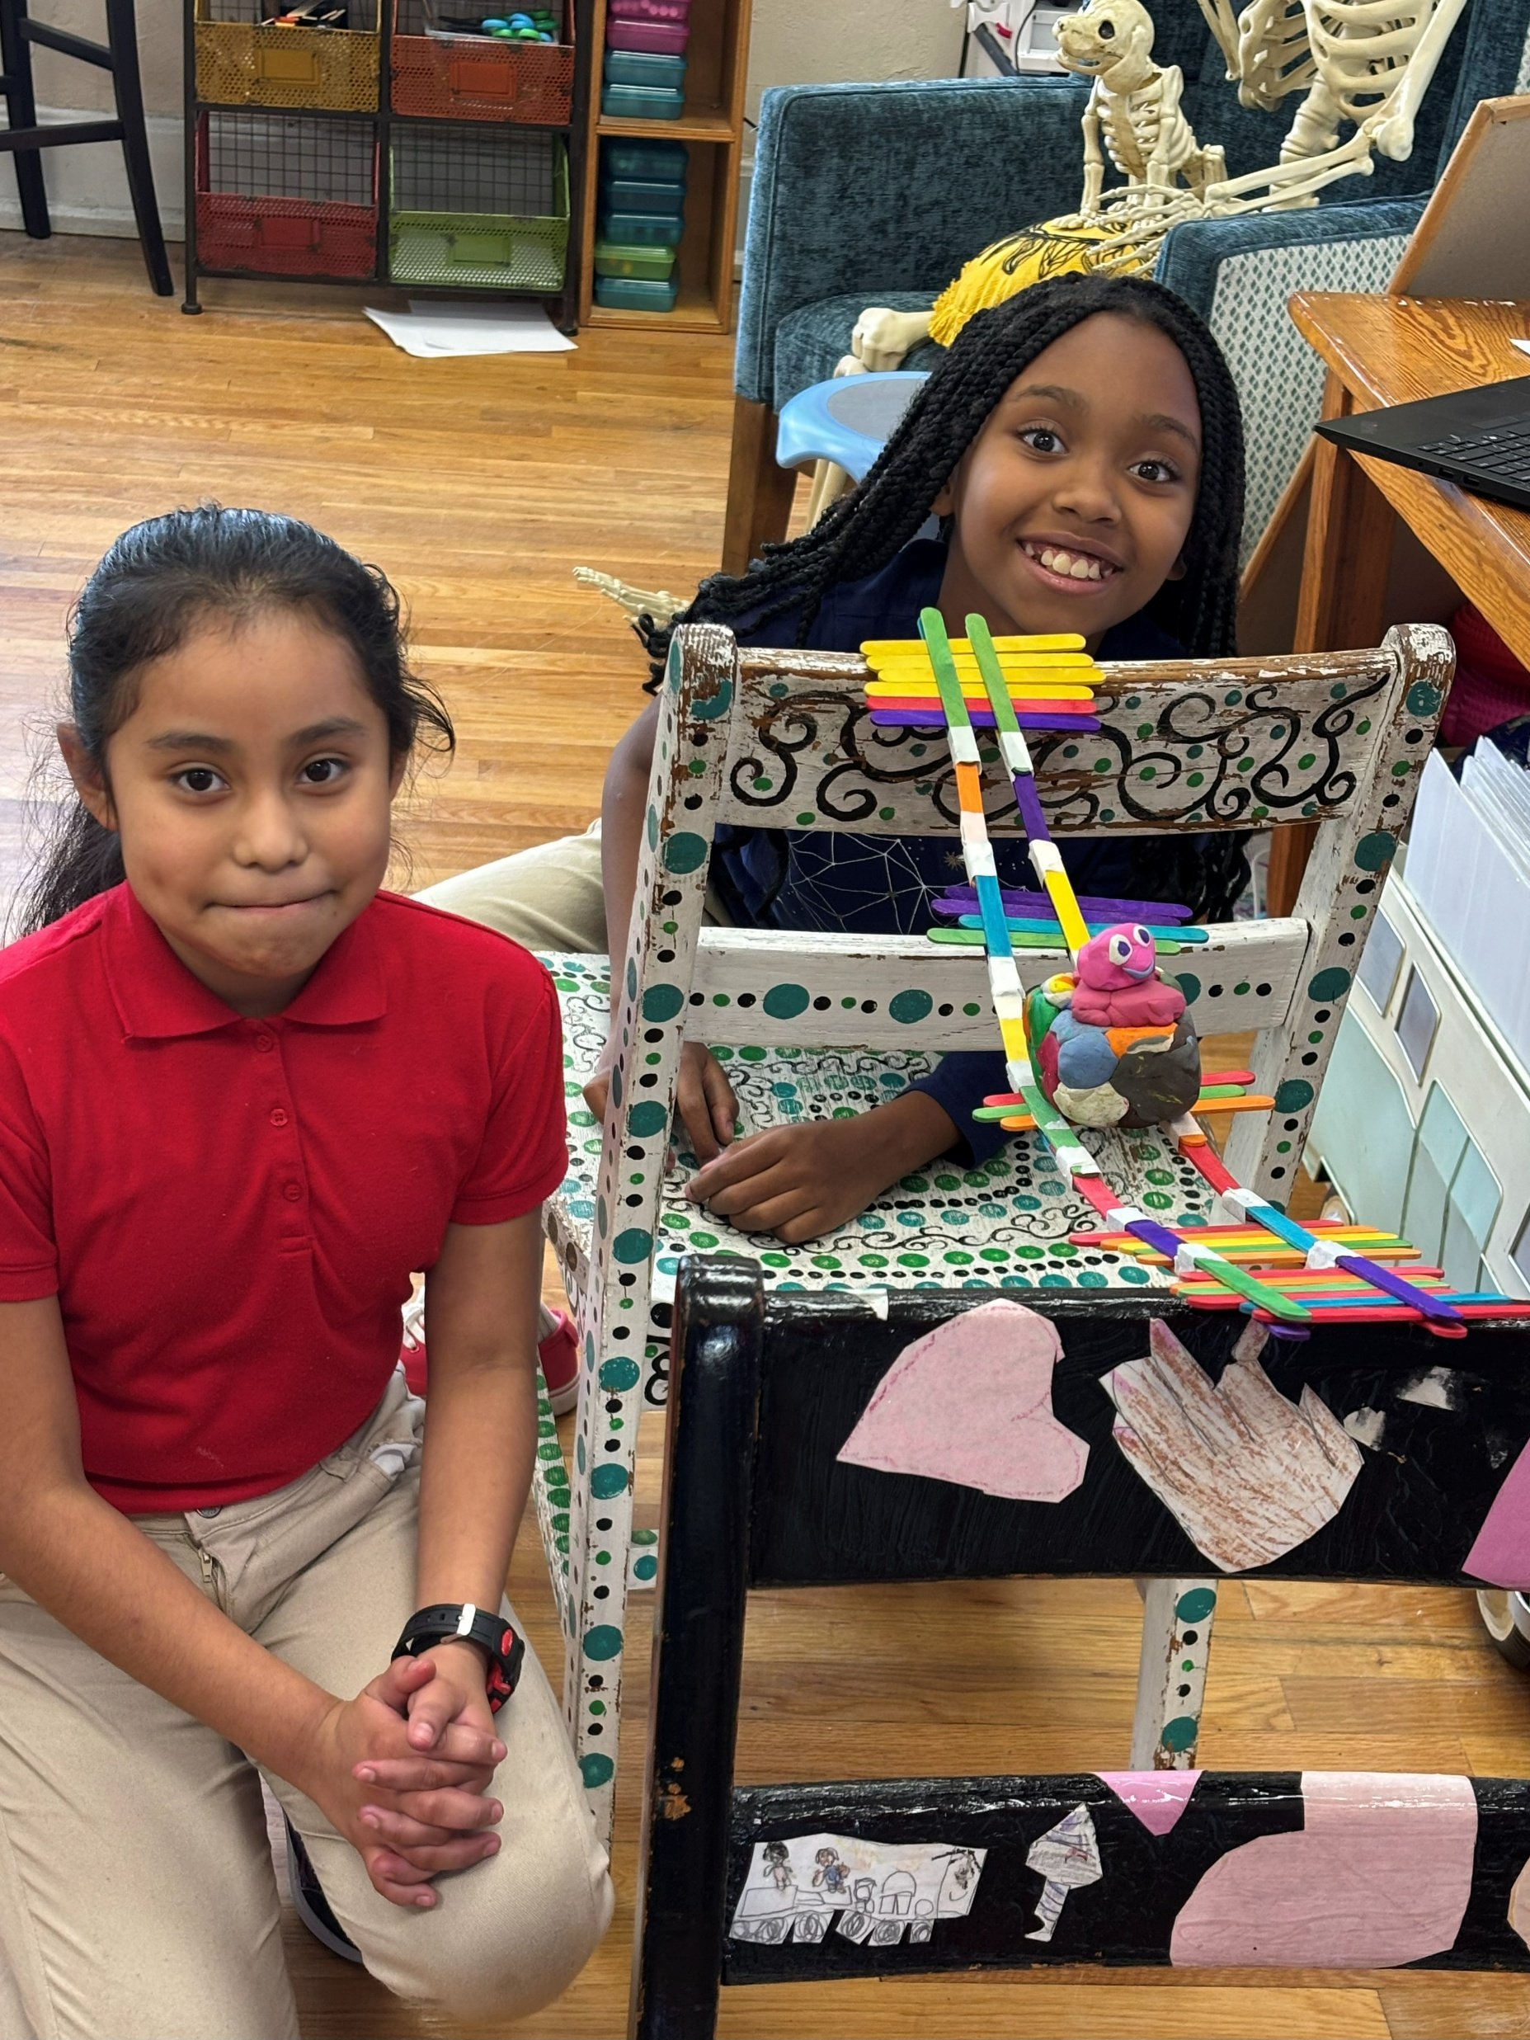
https://www.youtube.com/watch?v=dbTTsi4XshQ
Dekaub County bridge building

Slide 14
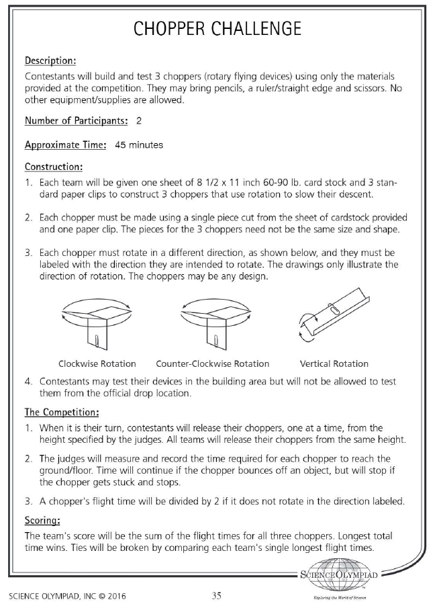
Chopper Challenge NEW for 2025
https://www.youtube.com/watch?v=5Vk-gXwHDSM&list=PLigo5ve7mrhpUND7p8IhMEb-2pcHkFQRq&index=3
How to Make a chopper
https://www.youtube.com/watch?v=Cv6ck1GrM3M

Slide 15
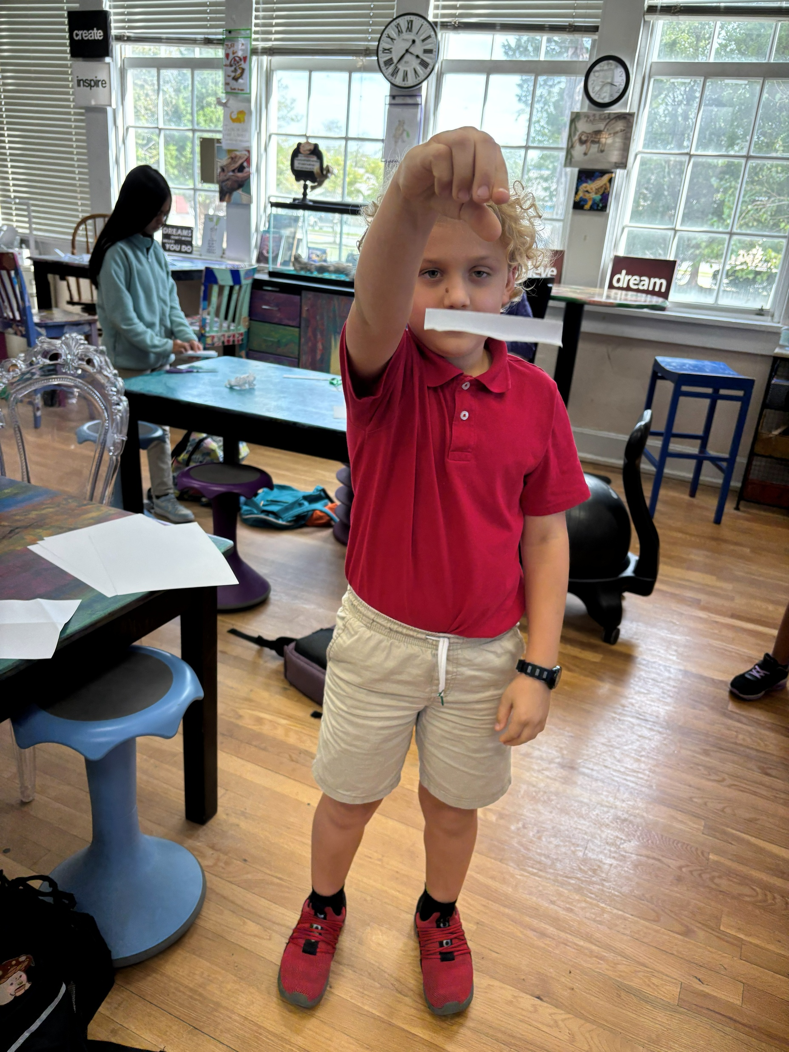
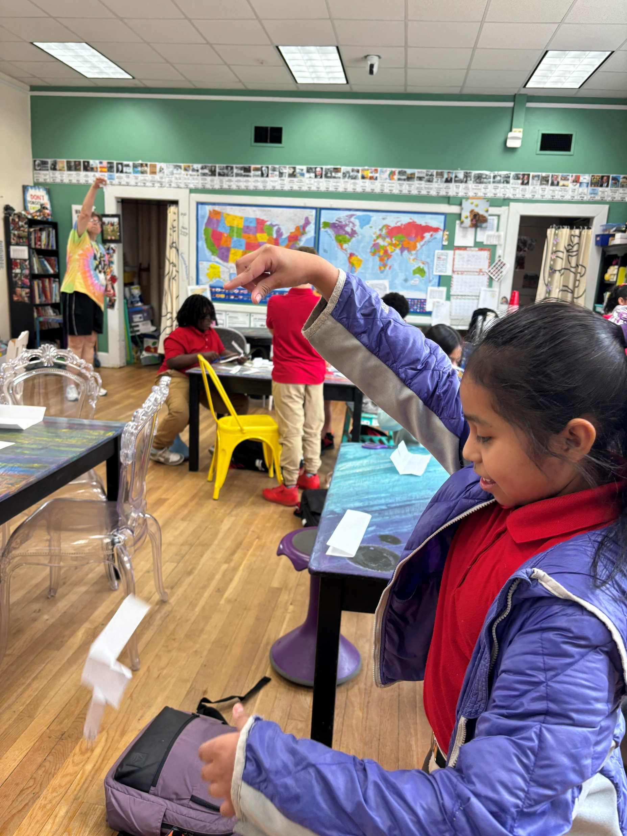

Slide 16
Crime Busters
Description: The students will identify unknown powders, match fingerprints, and use chromatography to identify a note found a crime scene.
Team Members: 2 students
The Rules:
The possible powders used will be; salt, granulated sugar, Plaster of Paris, salt, cornstarch, baking soda, limestone, and sand.
Each team will receive 7 vials each containing one substance and two vials containing a mixture of two substances. They will also receive water, vinegar, iodine solution, a magnifying glass, and several plastic cups.
Students will be given a set of fingerprints from several suspects and they will be tasked with matching them to the fingerprints found at the crime scene.
Students will create a chromatogram from a pen and use this to help identify the criminals.
Students will identify who committed the crime and why.
Scoring:
The score will be determine using the following formula: identification of powders - 50%, chromatography - 15%, fingerprints - 10%, and identification of the criminals 25%.
Practice Suggestions:
Fingerprints: Many cards can be found online. Give students a magnifying glass and have them match prints from different samples. Again, many can be found online by googling “fingerprint samples”.
Chromatography: Have students use chromatography paper (you can use paper towels or coffee filters) to complete chromatograph of pen ink. Many videos can be found on YouTube to give a demonstration.
Powders: Use the powders listed above. Students will need to identify each with a magnifying glass or mixing with water, vinegar, or iodine solution.

Slide 17
Science Olympiad Crime Busters- Chromatography demo
https://www.youtube.com/watch?v=1tOAc0vTjMM
Watch these videos!!!
Paper Chromatography
https://www.youtube.com/watch?v=TtAENPSThI4
Crime Buster notes
https://www.soinc.org/science-crime-busters-notes

Slide 18
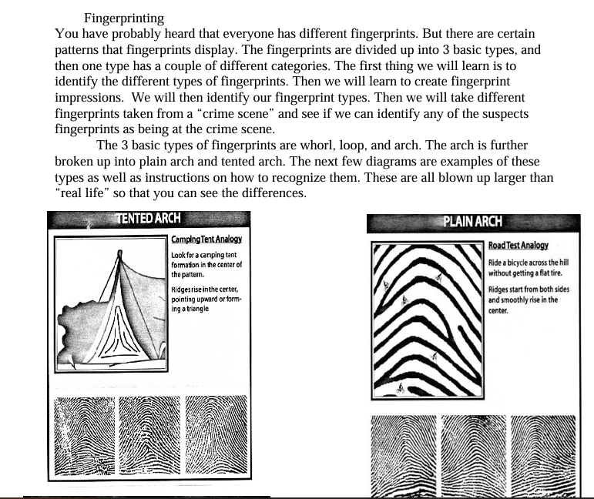
https://www.youtube.com/watch?v=1G03TEN3w2o
Very basics about fingerprints
Whorl
Loop
Arch

Slide 19
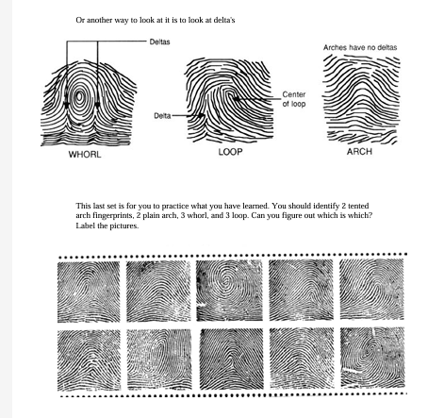
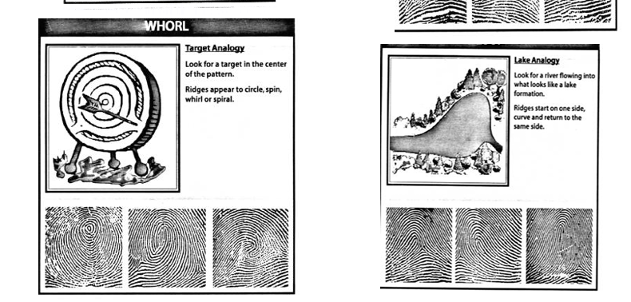

Slide 20
Data Crunchers

Slide 21
Deep Blue Sea
https://gmscienceolympiad.weebly.com/deep-blue-sea.html

Slide 22
Disease Detectives
https://www.soinc.org/disease-detectives-c

Slide 23
Egg Drop
Egg Drop: No parachute. The students will receive 20 packing peanuts, 2 pieces of paper, 36’’ of masking tape, and some scissors. They will have about 20 minutes to construct a device to drop about 3 meters. The goal is to have an unbroken egg and drop on a target. Winners will be decided by no broken egg and closest to target. So build a device that does not roll😊
- Mr. Ben Travers

Slide 24
Grab a Gram
https://www.facebook.com/watch/?v=488410092070530
Description: Teams will work together to pick up 50-75 grams of two different sets of materials. There will be two different rounds using different materials.
Each team member picks up some of the given material and places it in the provided container for delivery to the judges for massing. The object of Discovering STEM Program the activity is to come as close to 50 grams as possible when obtaining the samples.
Team Members: 2 students
The Rules:
Each student will have to pick up some of a material and place it in a clear cup. The amount will be specified at the event The materials could be one of the following: sand, paper clips, cereal, packing peanuts, beans, rice, etc.
Scoring:
The goal is to get as close to a set amount in grams as possible. Each team member will get a material and set amount any where between 50-75 grams. The team that gets closest to a combined total will win. If a team is given the amount of 50 grams and goes over 50, those points will be subtracted from 50 to find their score. For example, if a team scored 58 they would have 50 - 8 = 42. Any team scoring less than 50 per round will keep that exact score.
Practice Ideas:
Have students become familiar with what a gram, 25g, 50g, 100g, etc. feels like. Have them weigh certain materials to learn what their mass could be. We will use a brown paper lunch sack or a cup for measuring mass, so it is suggested to practice this way. Students will work together, so it is suggested to have them each become comfortable with what 50g feels like.

Slide 25
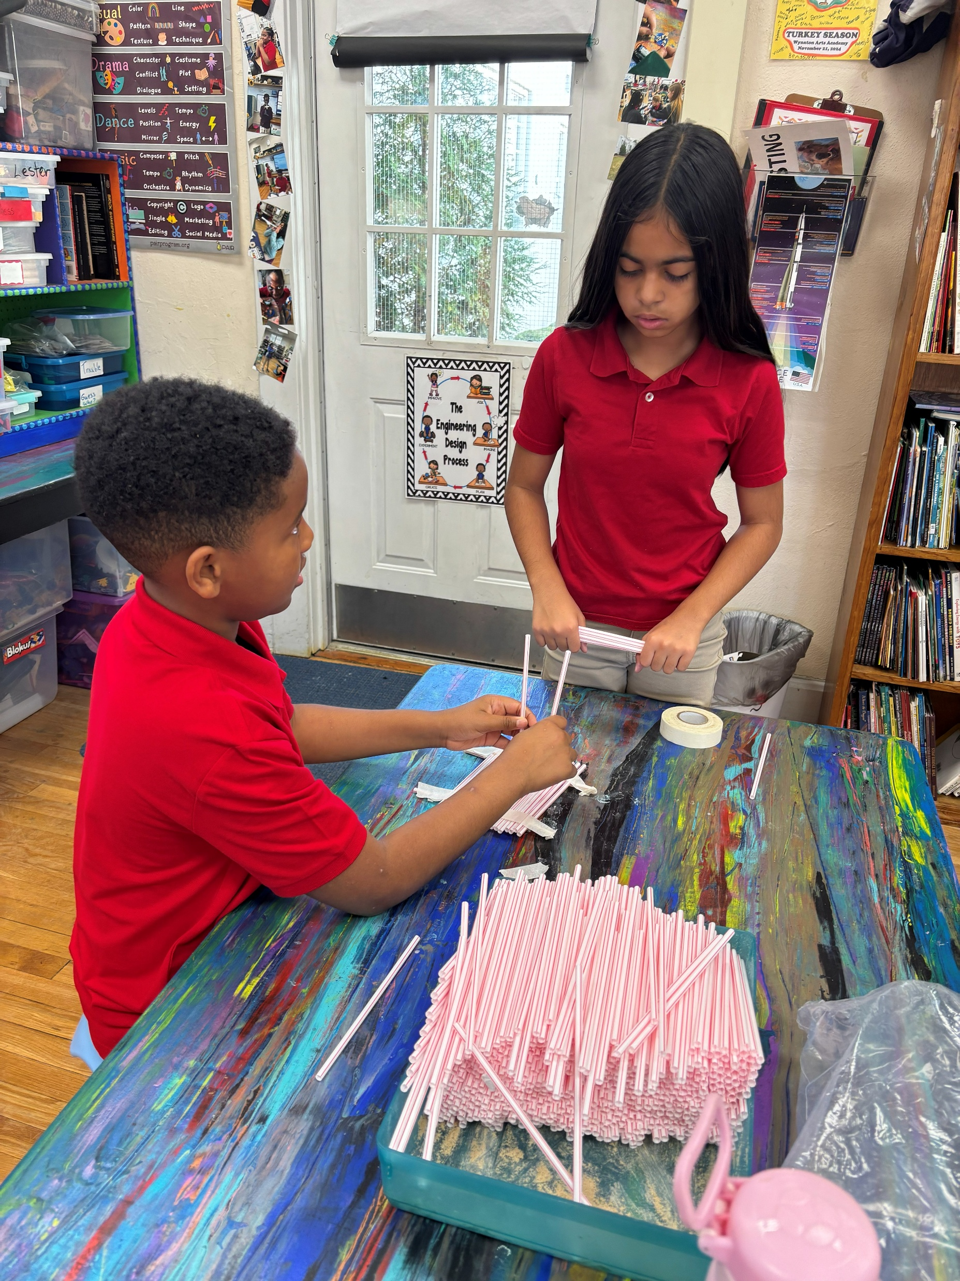
Mystery Architecture
Students will be given a mystery set of materials to build a freestanding tower as tall as they can. The tower should be constructed to support a tennis ball at its top.

Slide 26
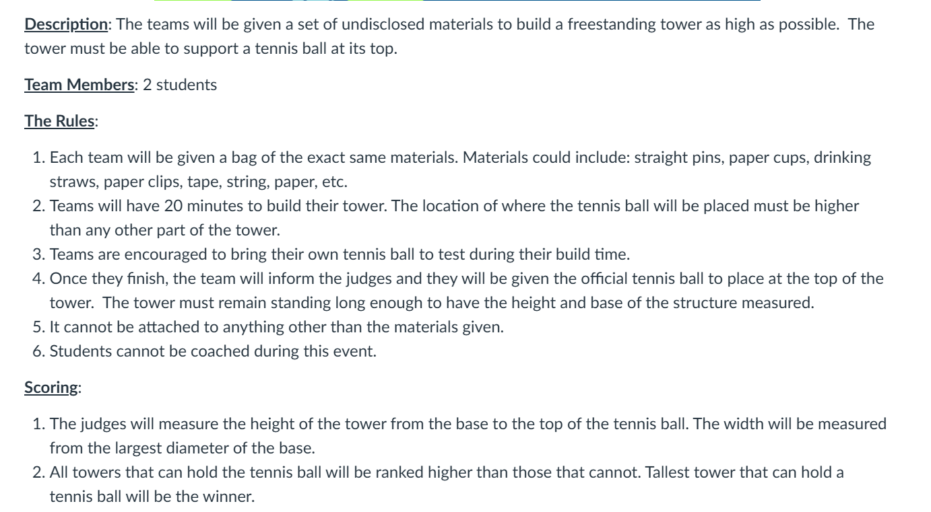

Slide 27
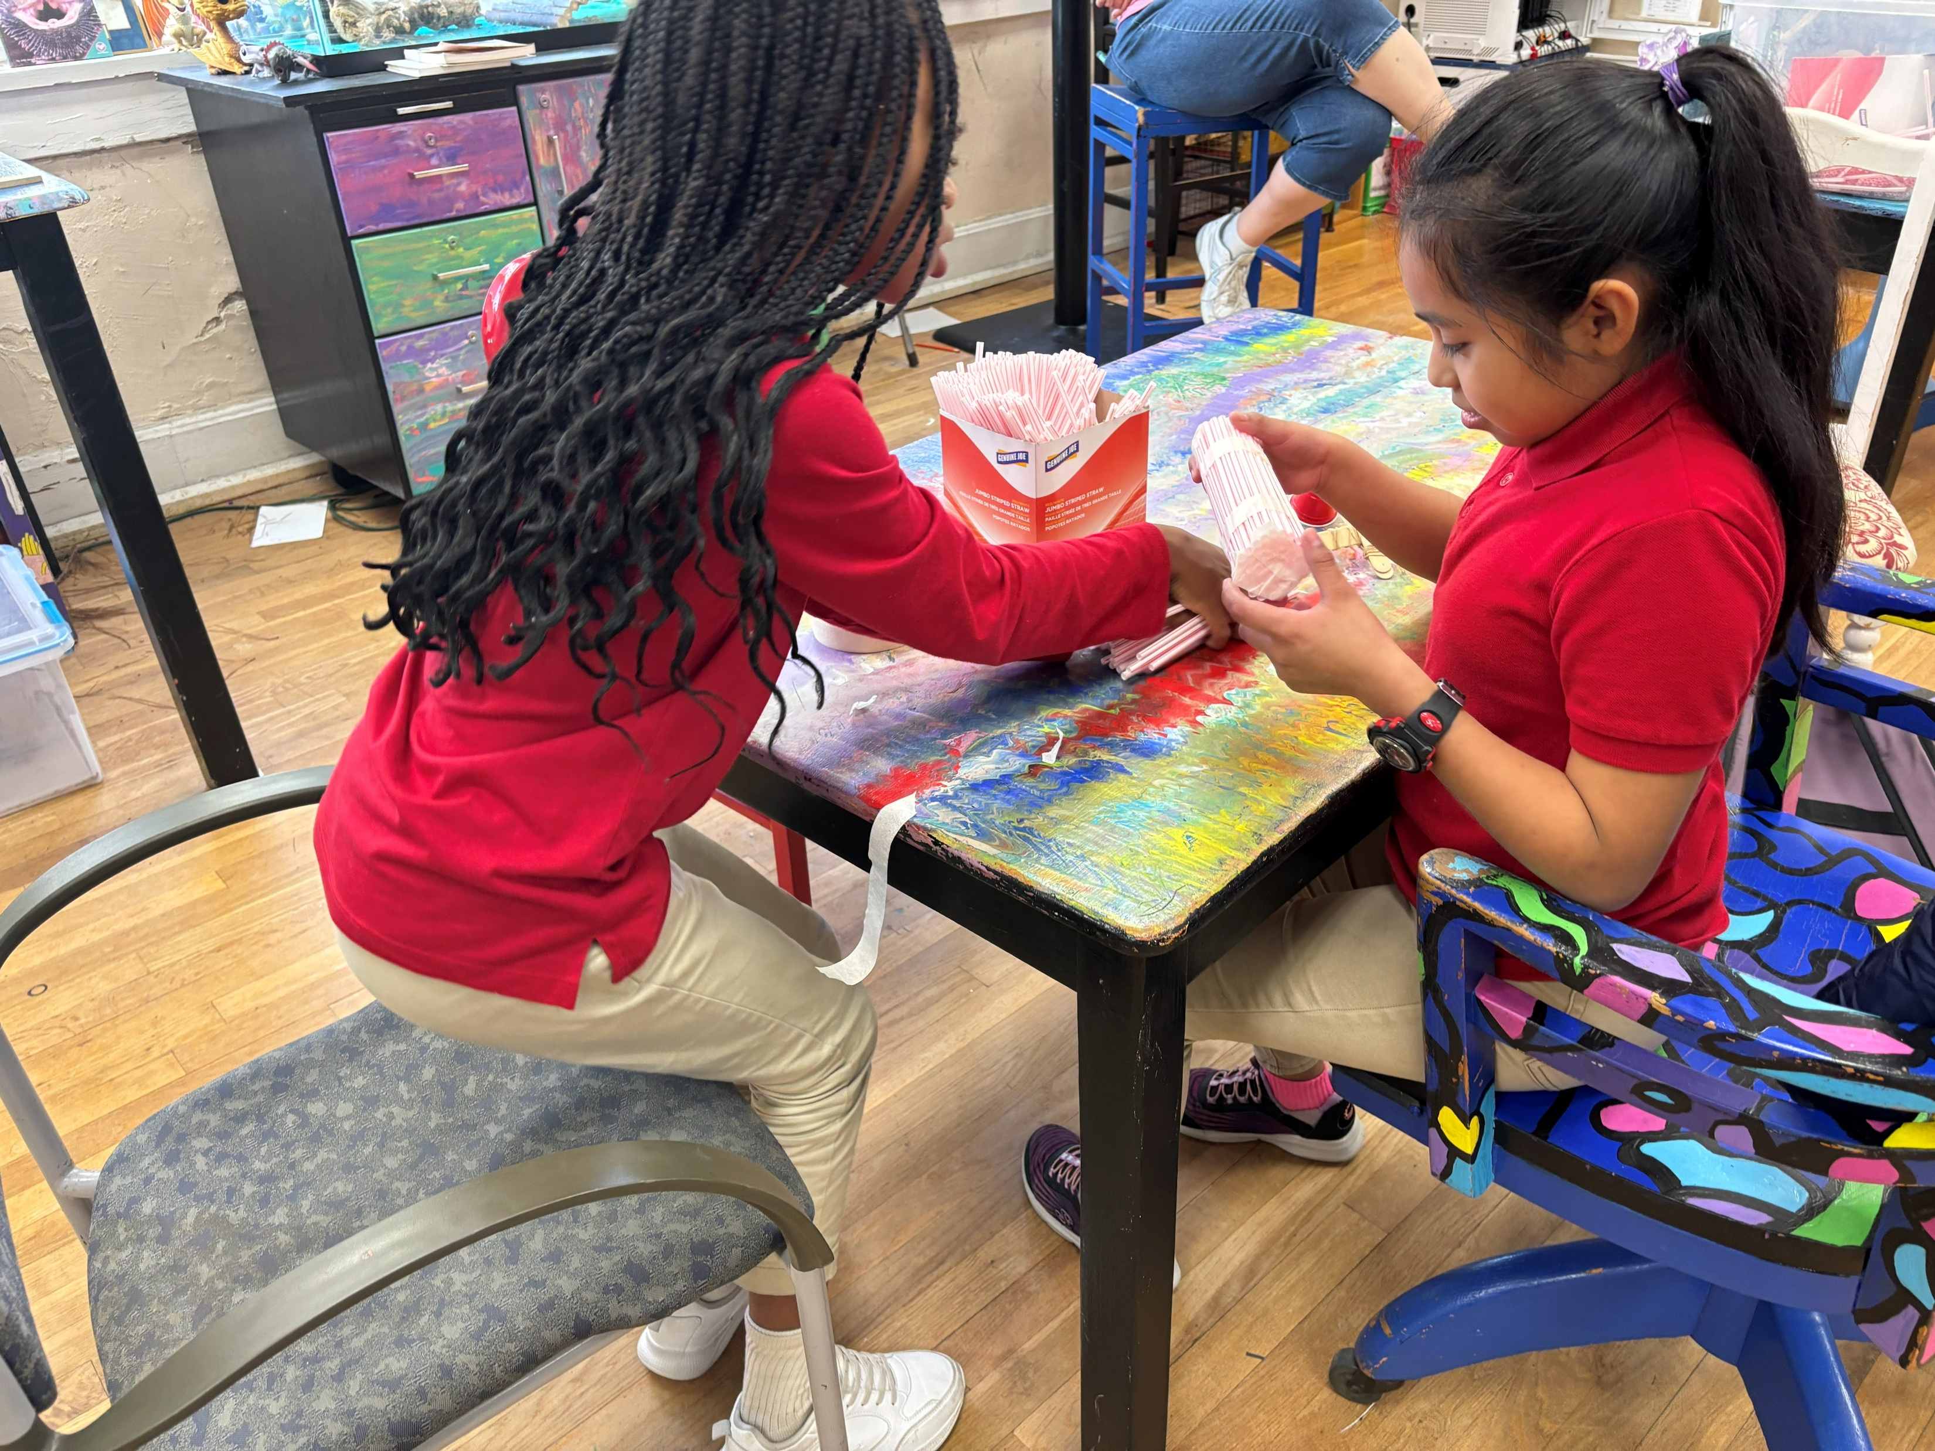
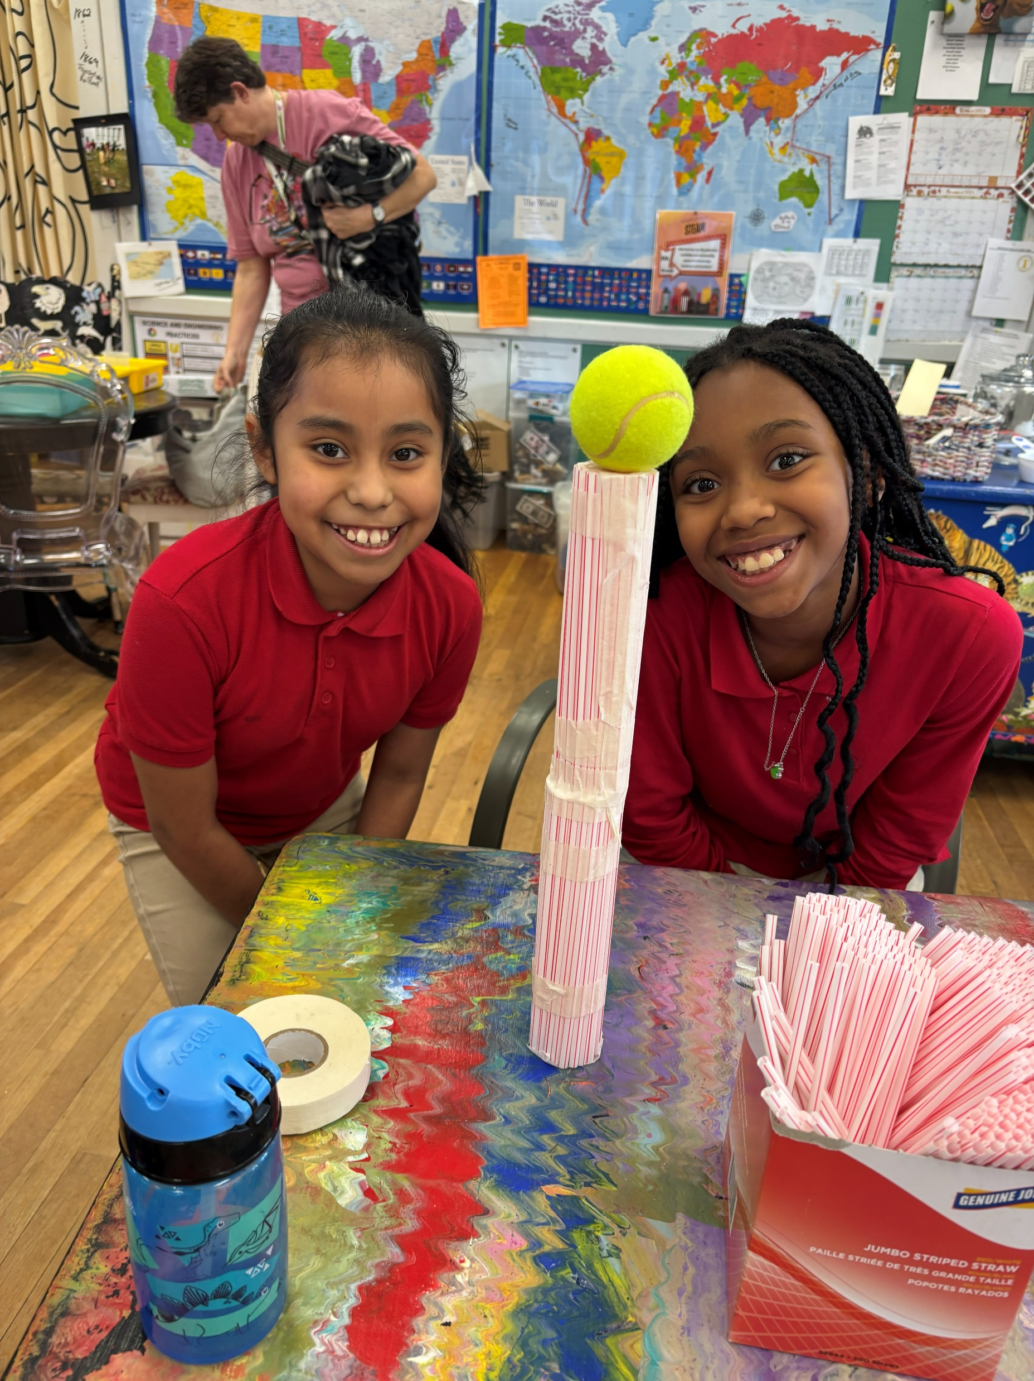
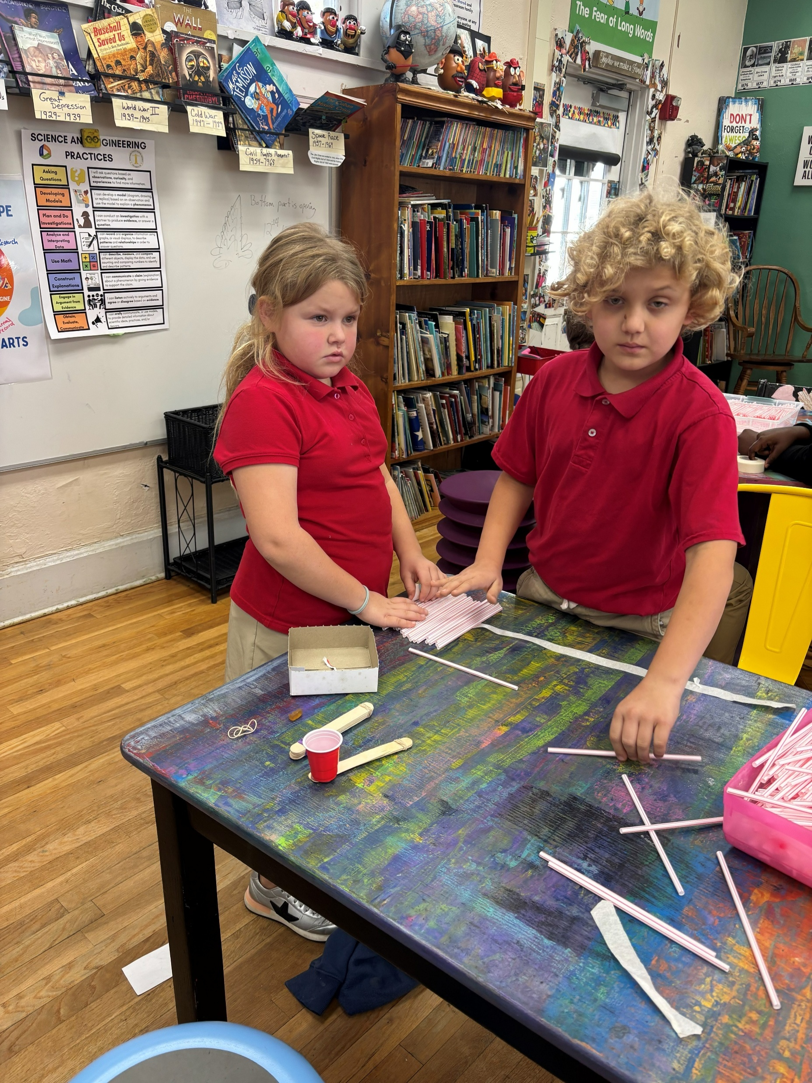

Slide 29
No Bones About It

Slide 30
Paper Rockets

Slide 31
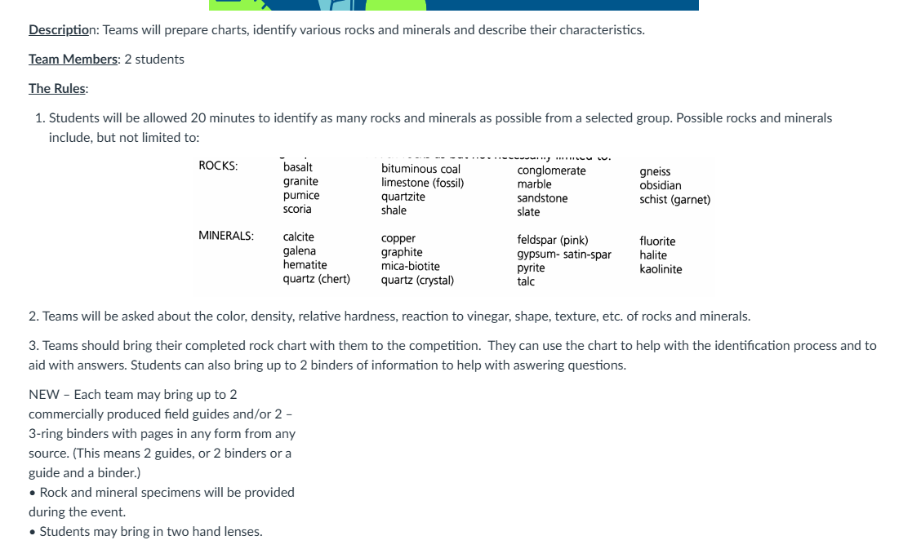
Rock Hound

Slide 32
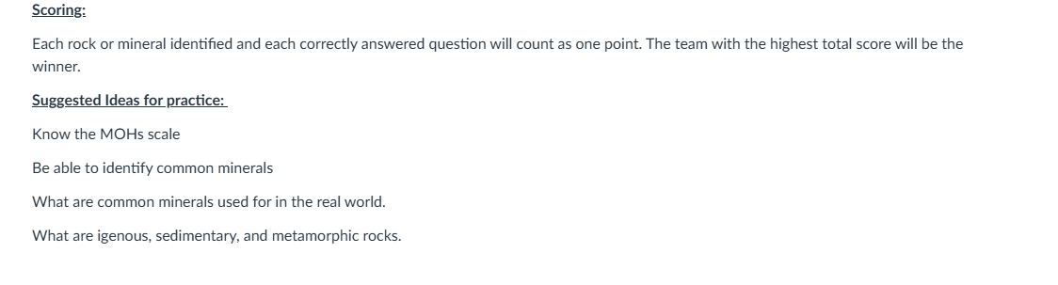
https://www.youtube.com/watch?v=90L_yTqkbnc
Rock Hound Workshop

Slide 33
Starry Starry Night

Slide 34
Water Rockets

Slide 35
Weather or Not

