Slide 1
Electricity
Shockingly scientific

Slide 2
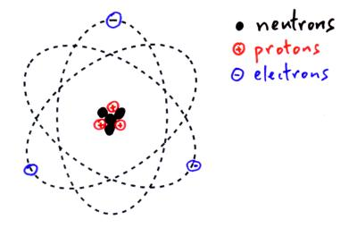
It starts with Atoms
Atoms contain protons with a positive charge (+), electrons with a negative charge (-), and neutrons with no charge.
Electricity occurs from the differences in charges.
Notice: There are 3 protons (+) and 3 electrons (-) making this atom electrically neutral.

Slide 3
Overall Charge
Atoms can have an overall negative charge, positive charge, or neutral.

Slide 4
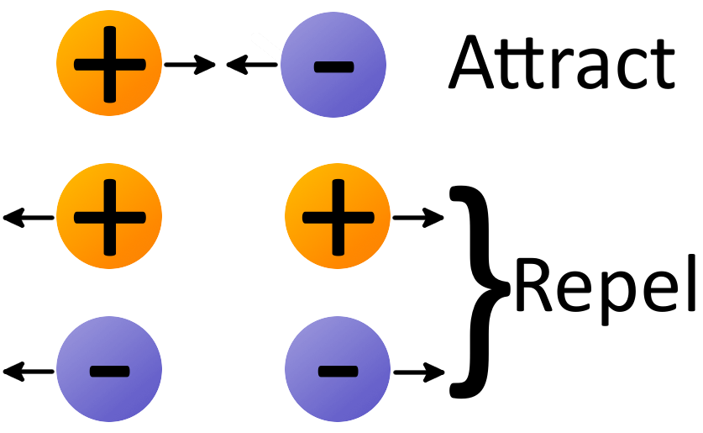
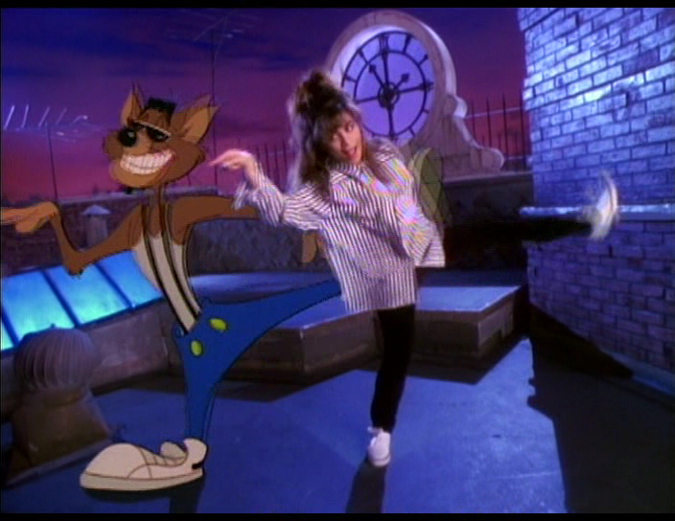
Opposites attract!
A force is a push or a pull.
Opposites attract or pull towards each other.
Like charges repel or pull away from each other.

Slide 5
Decide the charge of each balloon.

Slide 6
Decide the charge of each balloon.

Slide 7
Decide the charge of each balloon.

