Slide 1
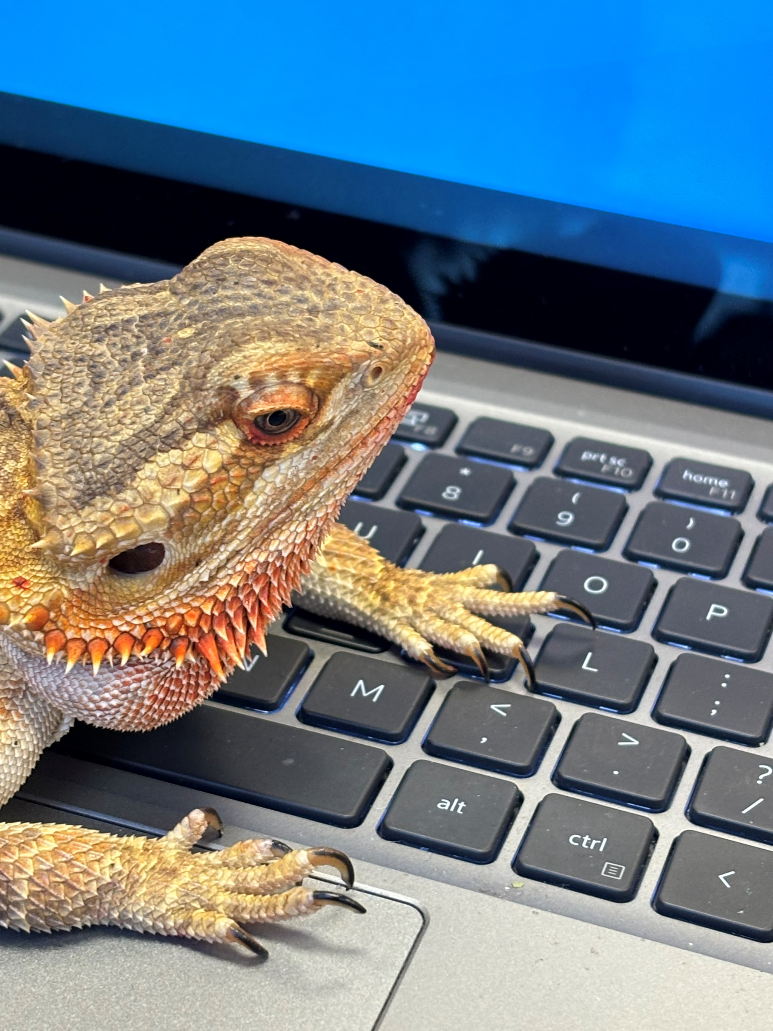
Remi
Welcome
to
Fifth Grade
with
Dr. Lester

Slide 2
Let’s Talk
Take Attendance
How are you getting home?

Slide 3
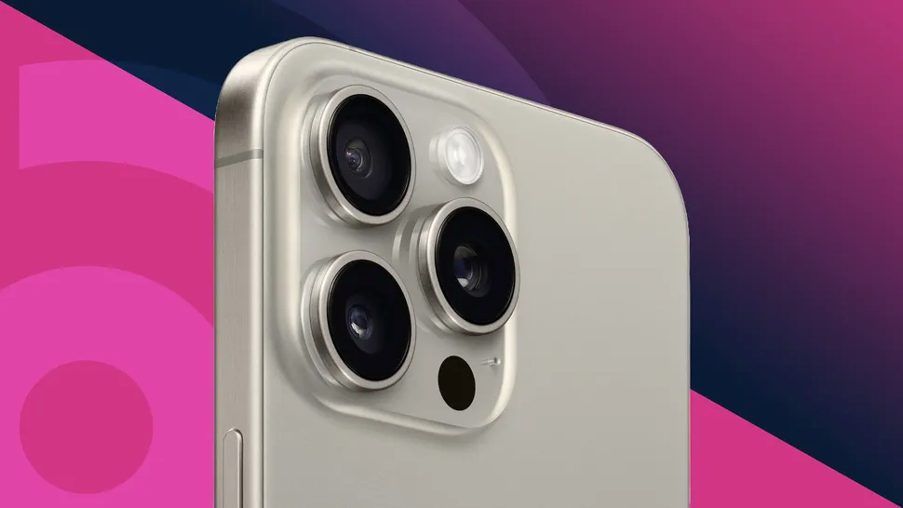
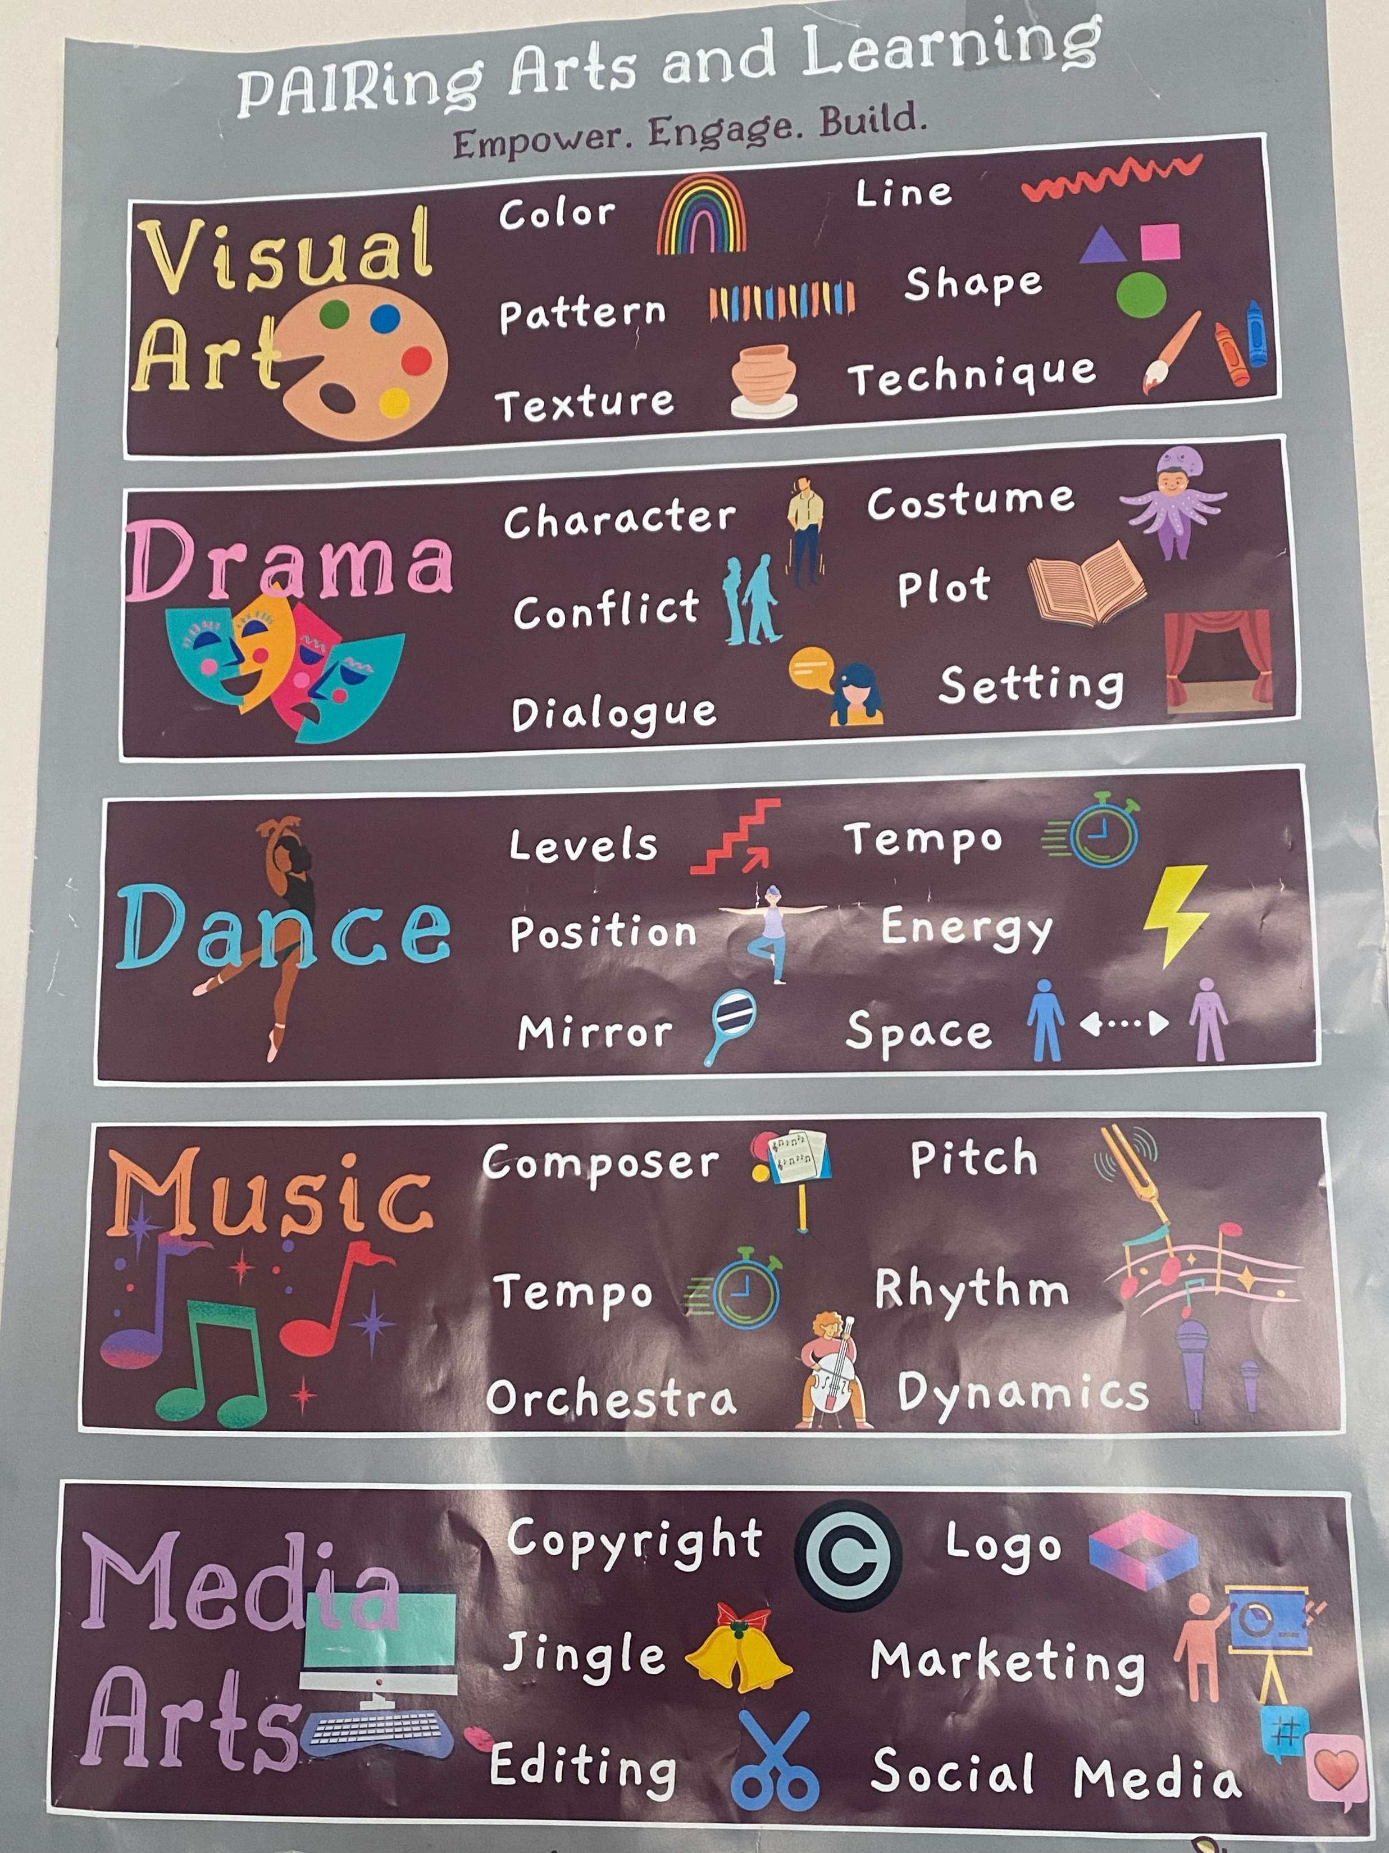
Picture Time

Slide 4

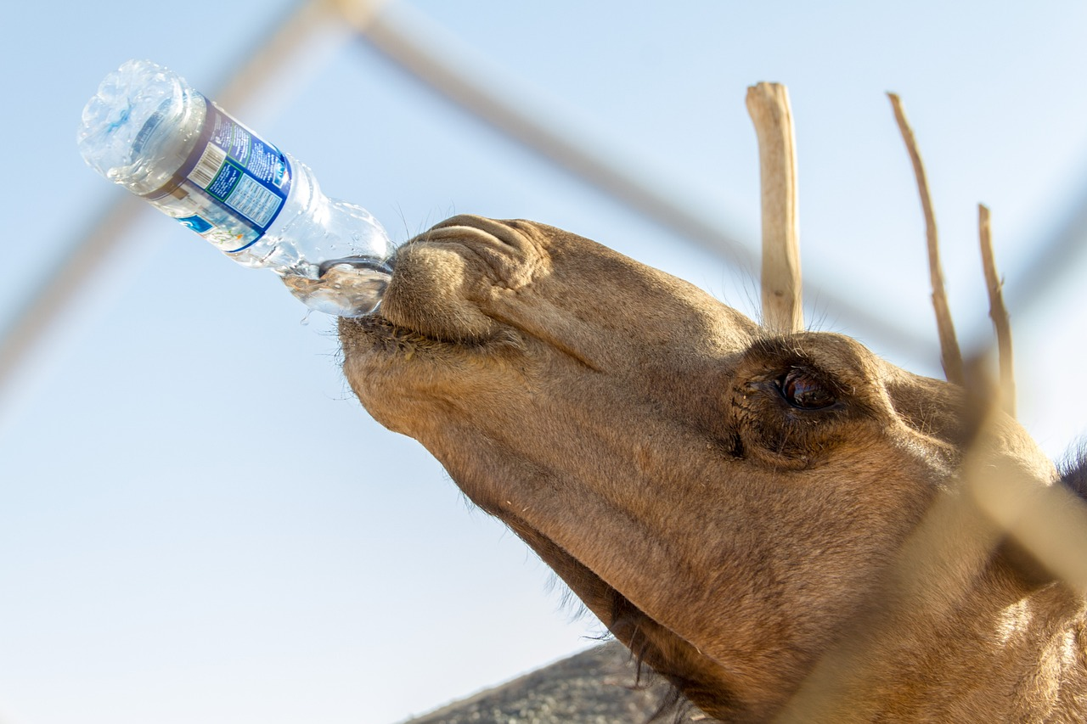
Water Bottles
ONLY CLEAR WATER…. ONLY WATER
Tops Only
Plastic preferred
WATER Only
No Straws
No GLASS
Keep it on The Cart

Slide 5
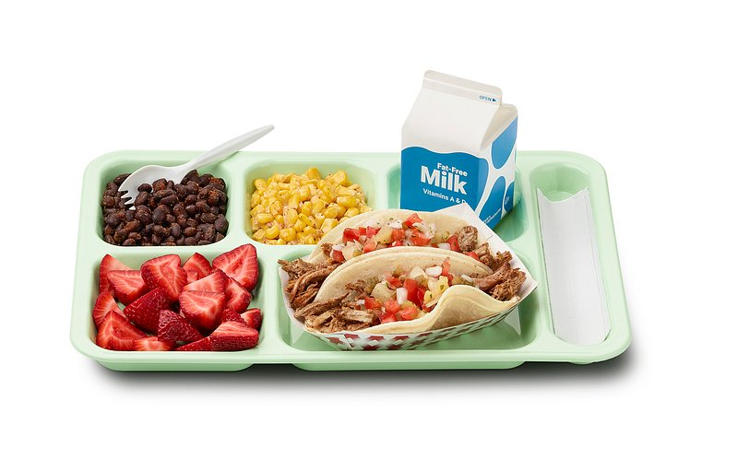

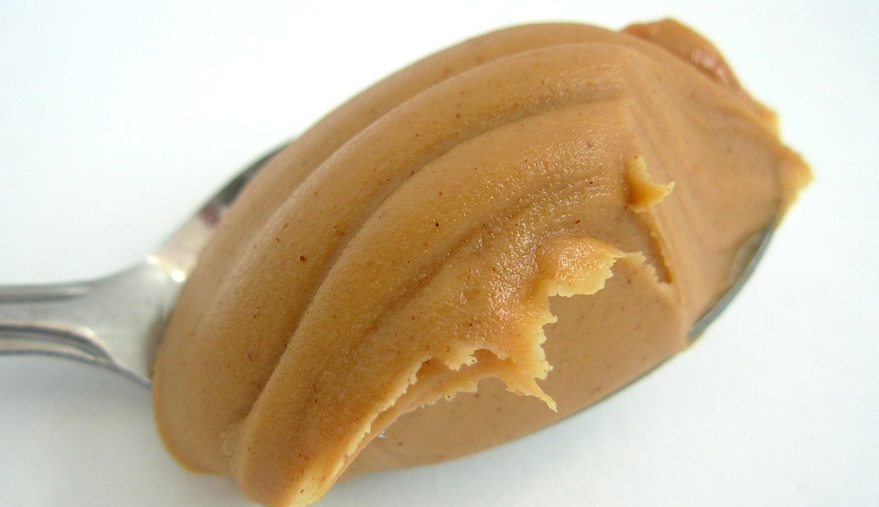
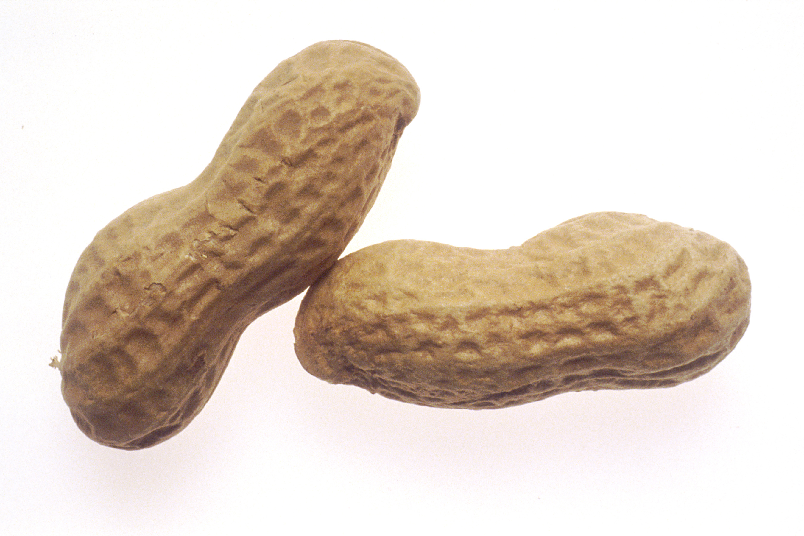
FOOD RULES
Wynnton is a
Peanut and Fish Free School
No peanut butter or seafood
Every kid at Wynnton may receive breakfast and lunch for free.
Breakfast is from 7:00- 7:30 in
the cafeteria.
NO outside food is allowed.

Slide 6
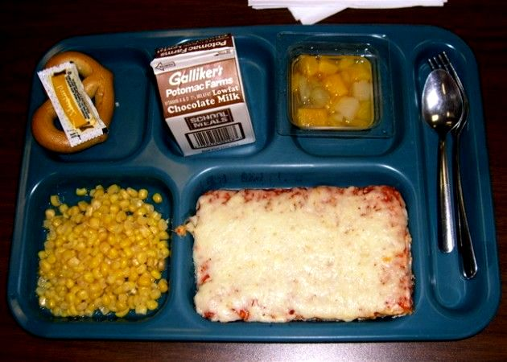
Lunch
If you bring a lunch, please bring what you will be eating
that day.
You may not heat up your lunch.
IF you bring a lunch and decide to get the school lunch,
that’s fine. Enjoy
Our school prefers store-bought cupcakes for those celebrating birthdays.
Principal Mumpower encourages bringing the mini cupcakes.
IF an adult brings a student’s lunch, they may have lunch outside on the patio.
No outside restaurant bags allowed.
SNACKS
We do not want bags of snacks to be shared with friends at lunch.
No purchasing snacks for others.
In other words, let’s not bring giant bags of Takis to share with just a few.
Single serving sized snack at lunch are great.
No Sneaky Snacking in the Classroom. Do not eat out of backpacks. Not cool.

Slide 7

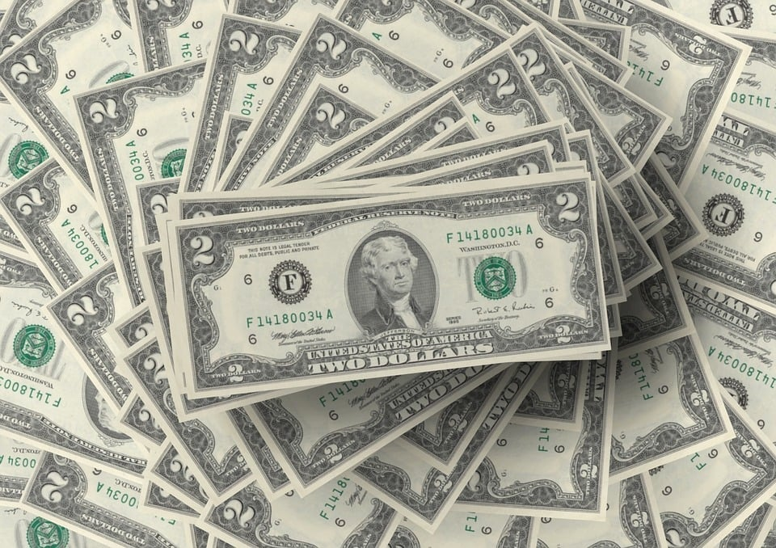
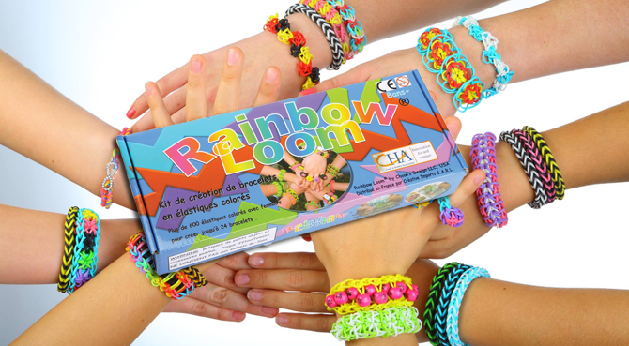
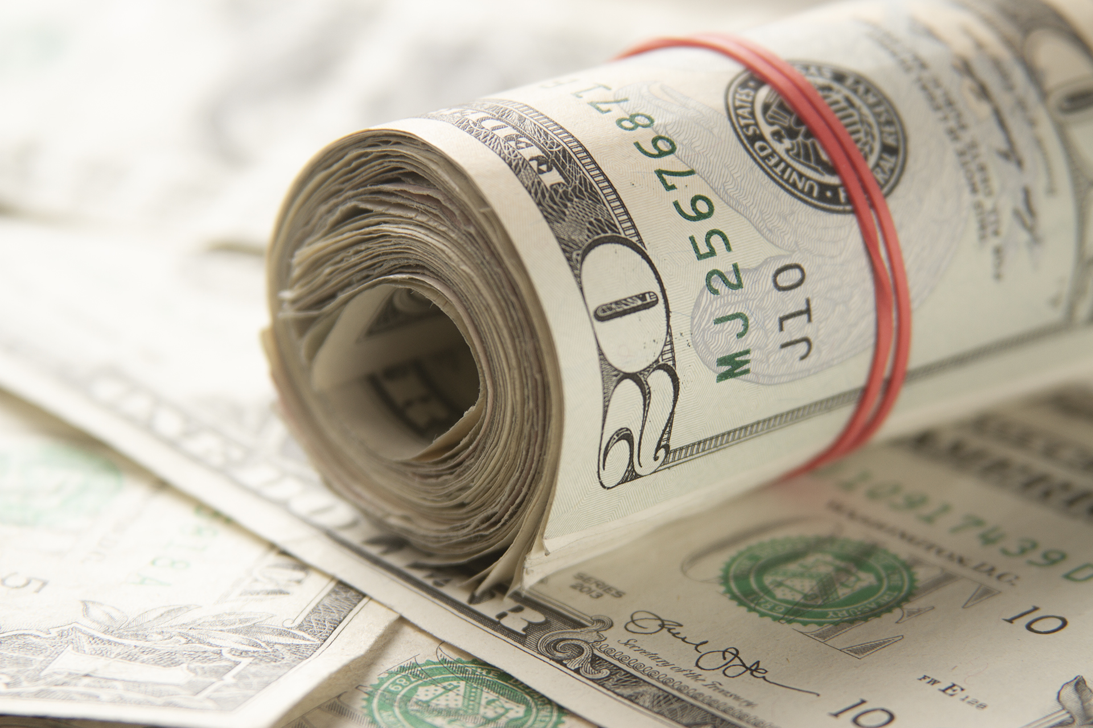
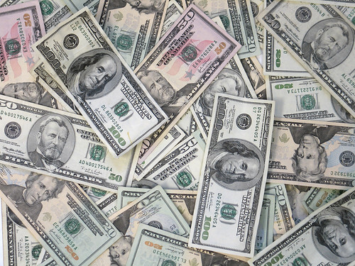
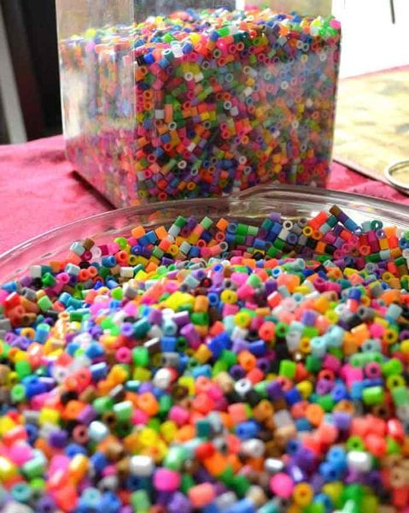
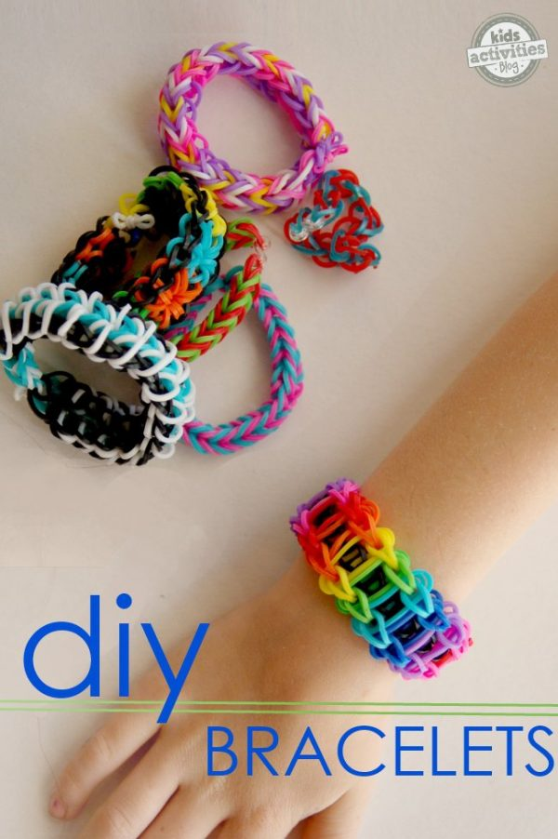
Students may not sell items of any kind at school.
There should never be an exchange of money between students at school.
Please, do not loan money for anything.
Ice cream, bookfair… NO LOANING $$$$$$

Slide 8
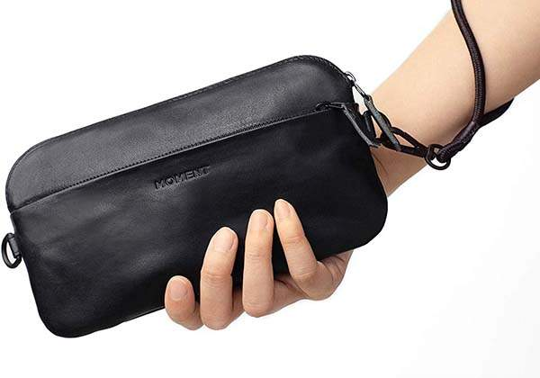
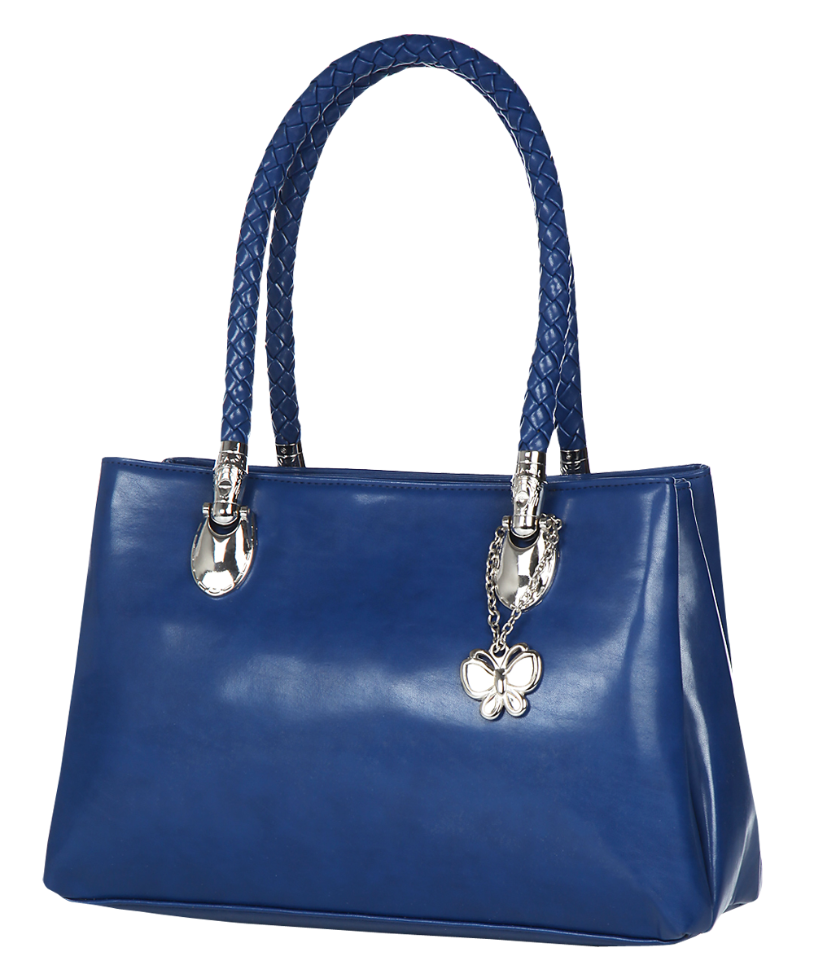

DO NOT CARRY PURSES at SCHOOL

Slide 9
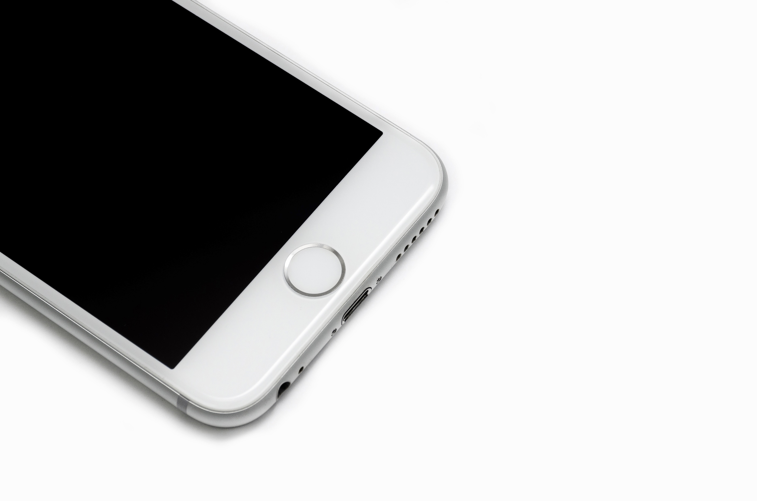
NO Cell Phones
NO Smart watches
NO Electronics
NO Toys

Slide 10
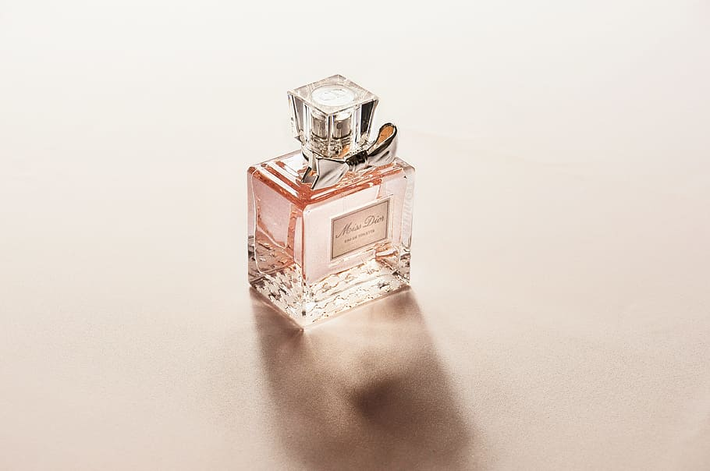
Please do not spray any type of perfume or deodorant in Dr. Lester’s Classroom.
Highly allergic to perfumes.
Please be kind.
This is a request from Dr. Lester

Slide 11
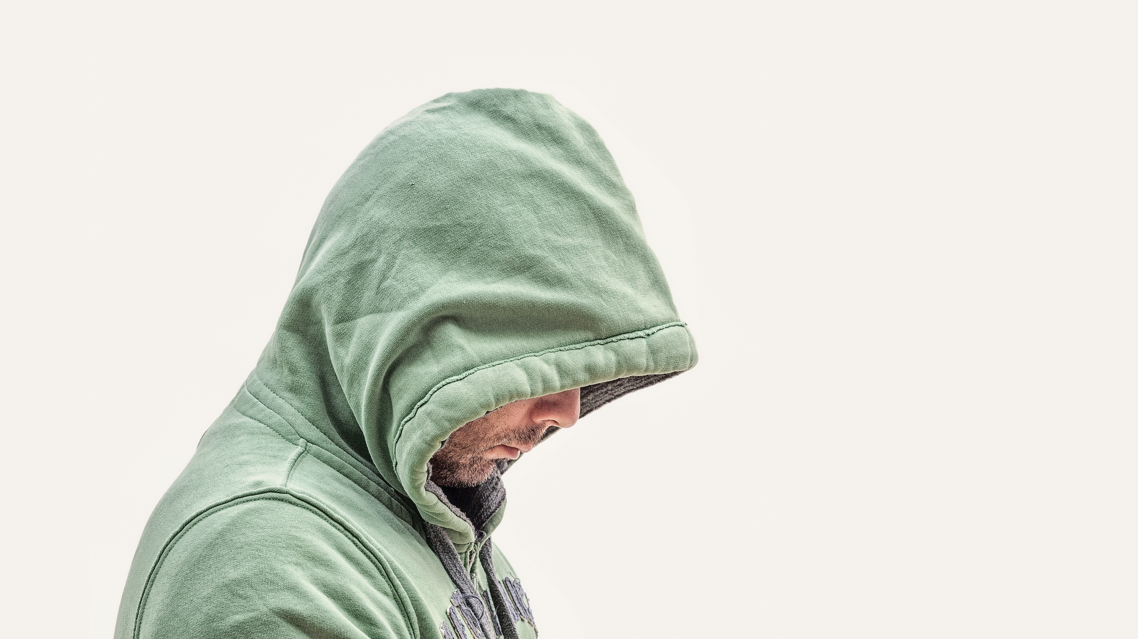
Please do not wear hoods in the building.
School rule

Slide 12
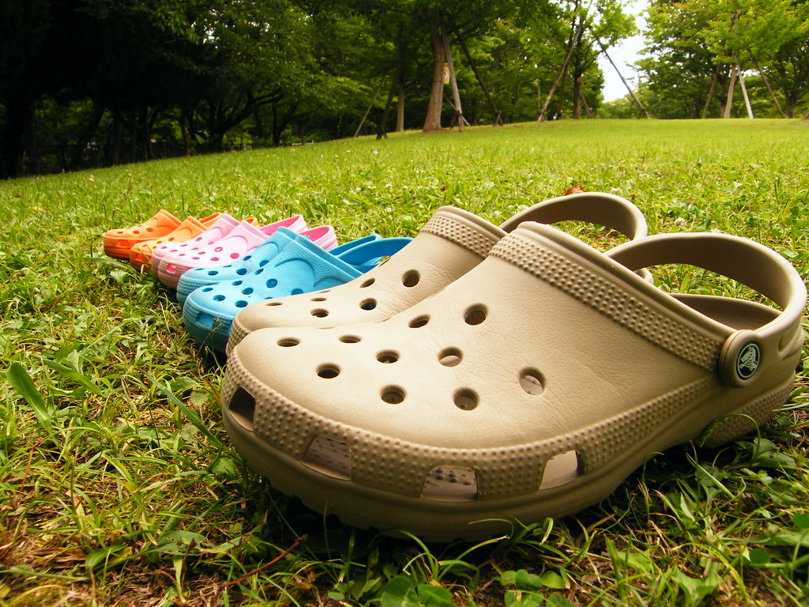
No Crocs
Or
Boots
This Photo by Unknown Author is licensed under CC BY

Slide 13
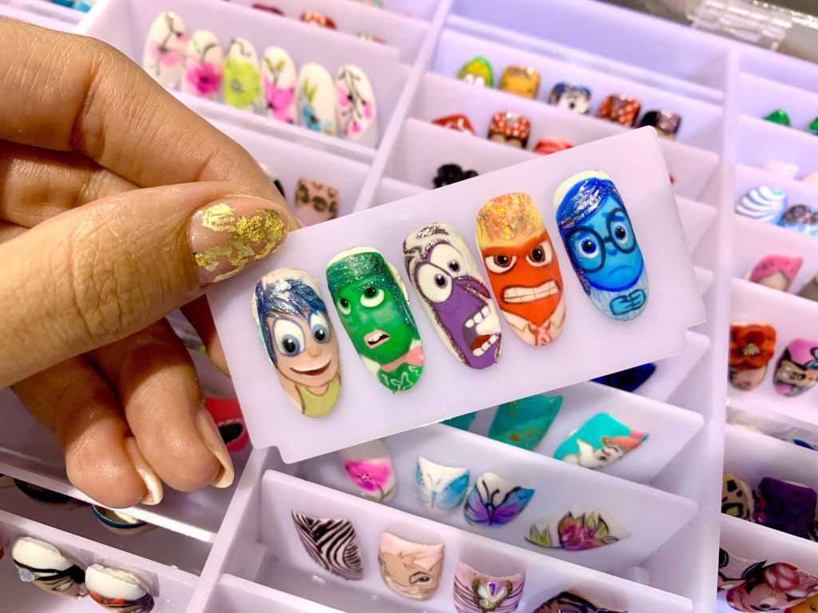
No Fake Nails
This Photo by Unknown Author is licensed under CC BY-SA-NC

Slide 14
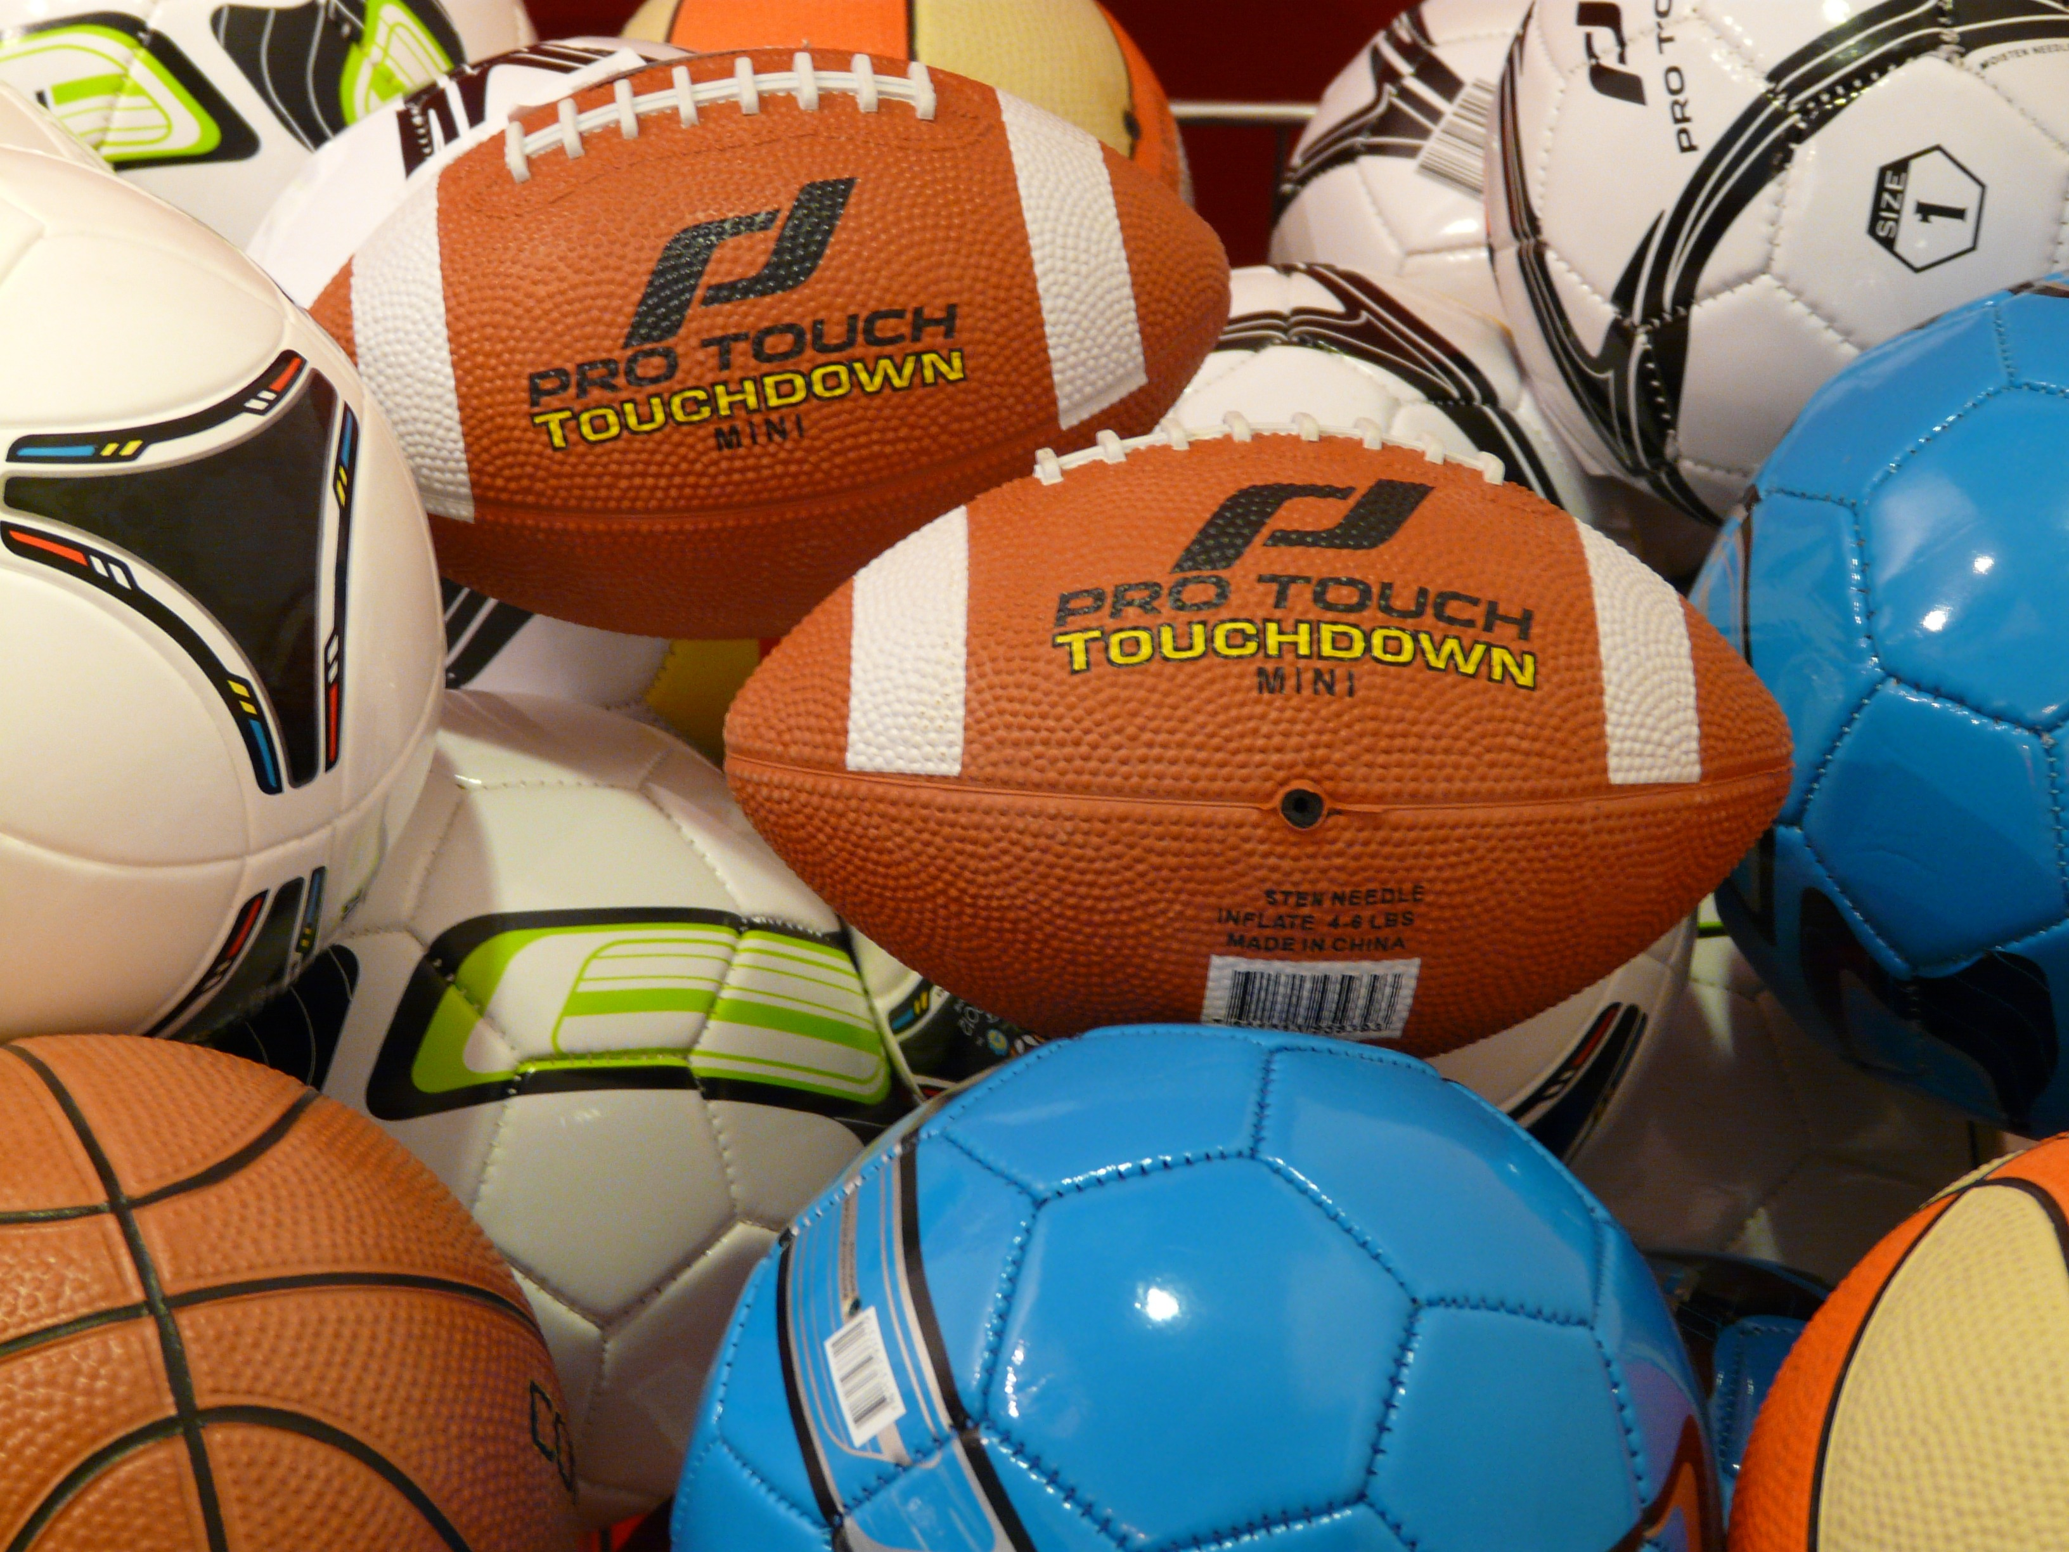
New Rule:
NO students allowed in the Gym equipment closet.
This means students may no longer get footballs for recess. Teachers must sign out equipment. Sorry guys.
Recess time will be about 20 minutes.

Slide 15
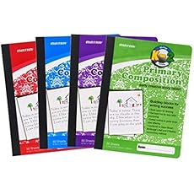
Supplies for Dr. Lester’s Class
2 Composition notebooks
Pencils
Headphones
Happy Attitude
Kind Heart
Curious mind with great questions
Might have more to come. This is a start.
Please leave all toys at home.
We have plenty of classroom toys. We do not need yours.

Slide 16
 | In Room 16
7:30 -8:05 | In Homeroom Orchestra (7:30-8:15)
8:05-9:25 | Lester’s HR – Swafford Swafford’s HR – HERE
9:25-10:45 | Lester’s HR – McClary McClary HR - HERE
10:50-11:30 | FINE ARTS M : Drama T: Art W: Music Th: Dance
11:30-12:45 | Lester HR (You are back here in homeroom with me)
12:40-1:10 | LUNCH
1:20-2:00 | PE /Coding/Robotics/ guidance PE : Mondays and Thursdays Recess or (counseling / robotics) – Tuesday
2:00 | Dismissal

Slide 17
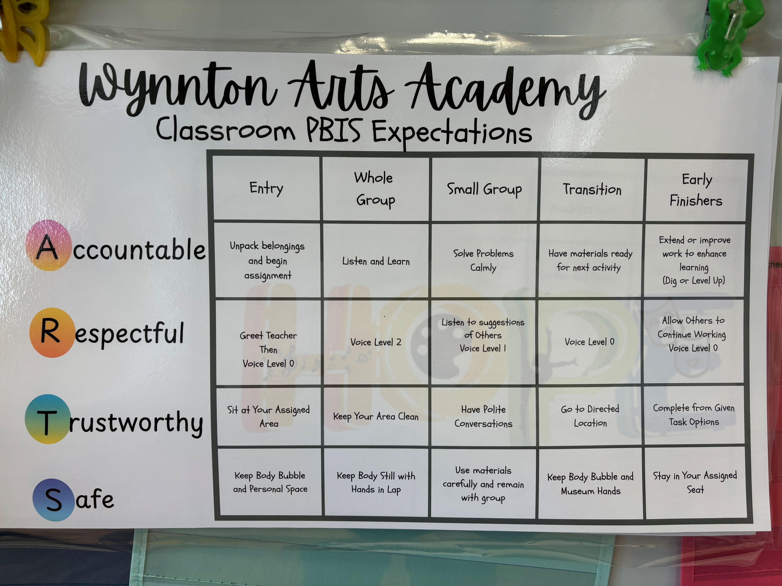

Slide 18
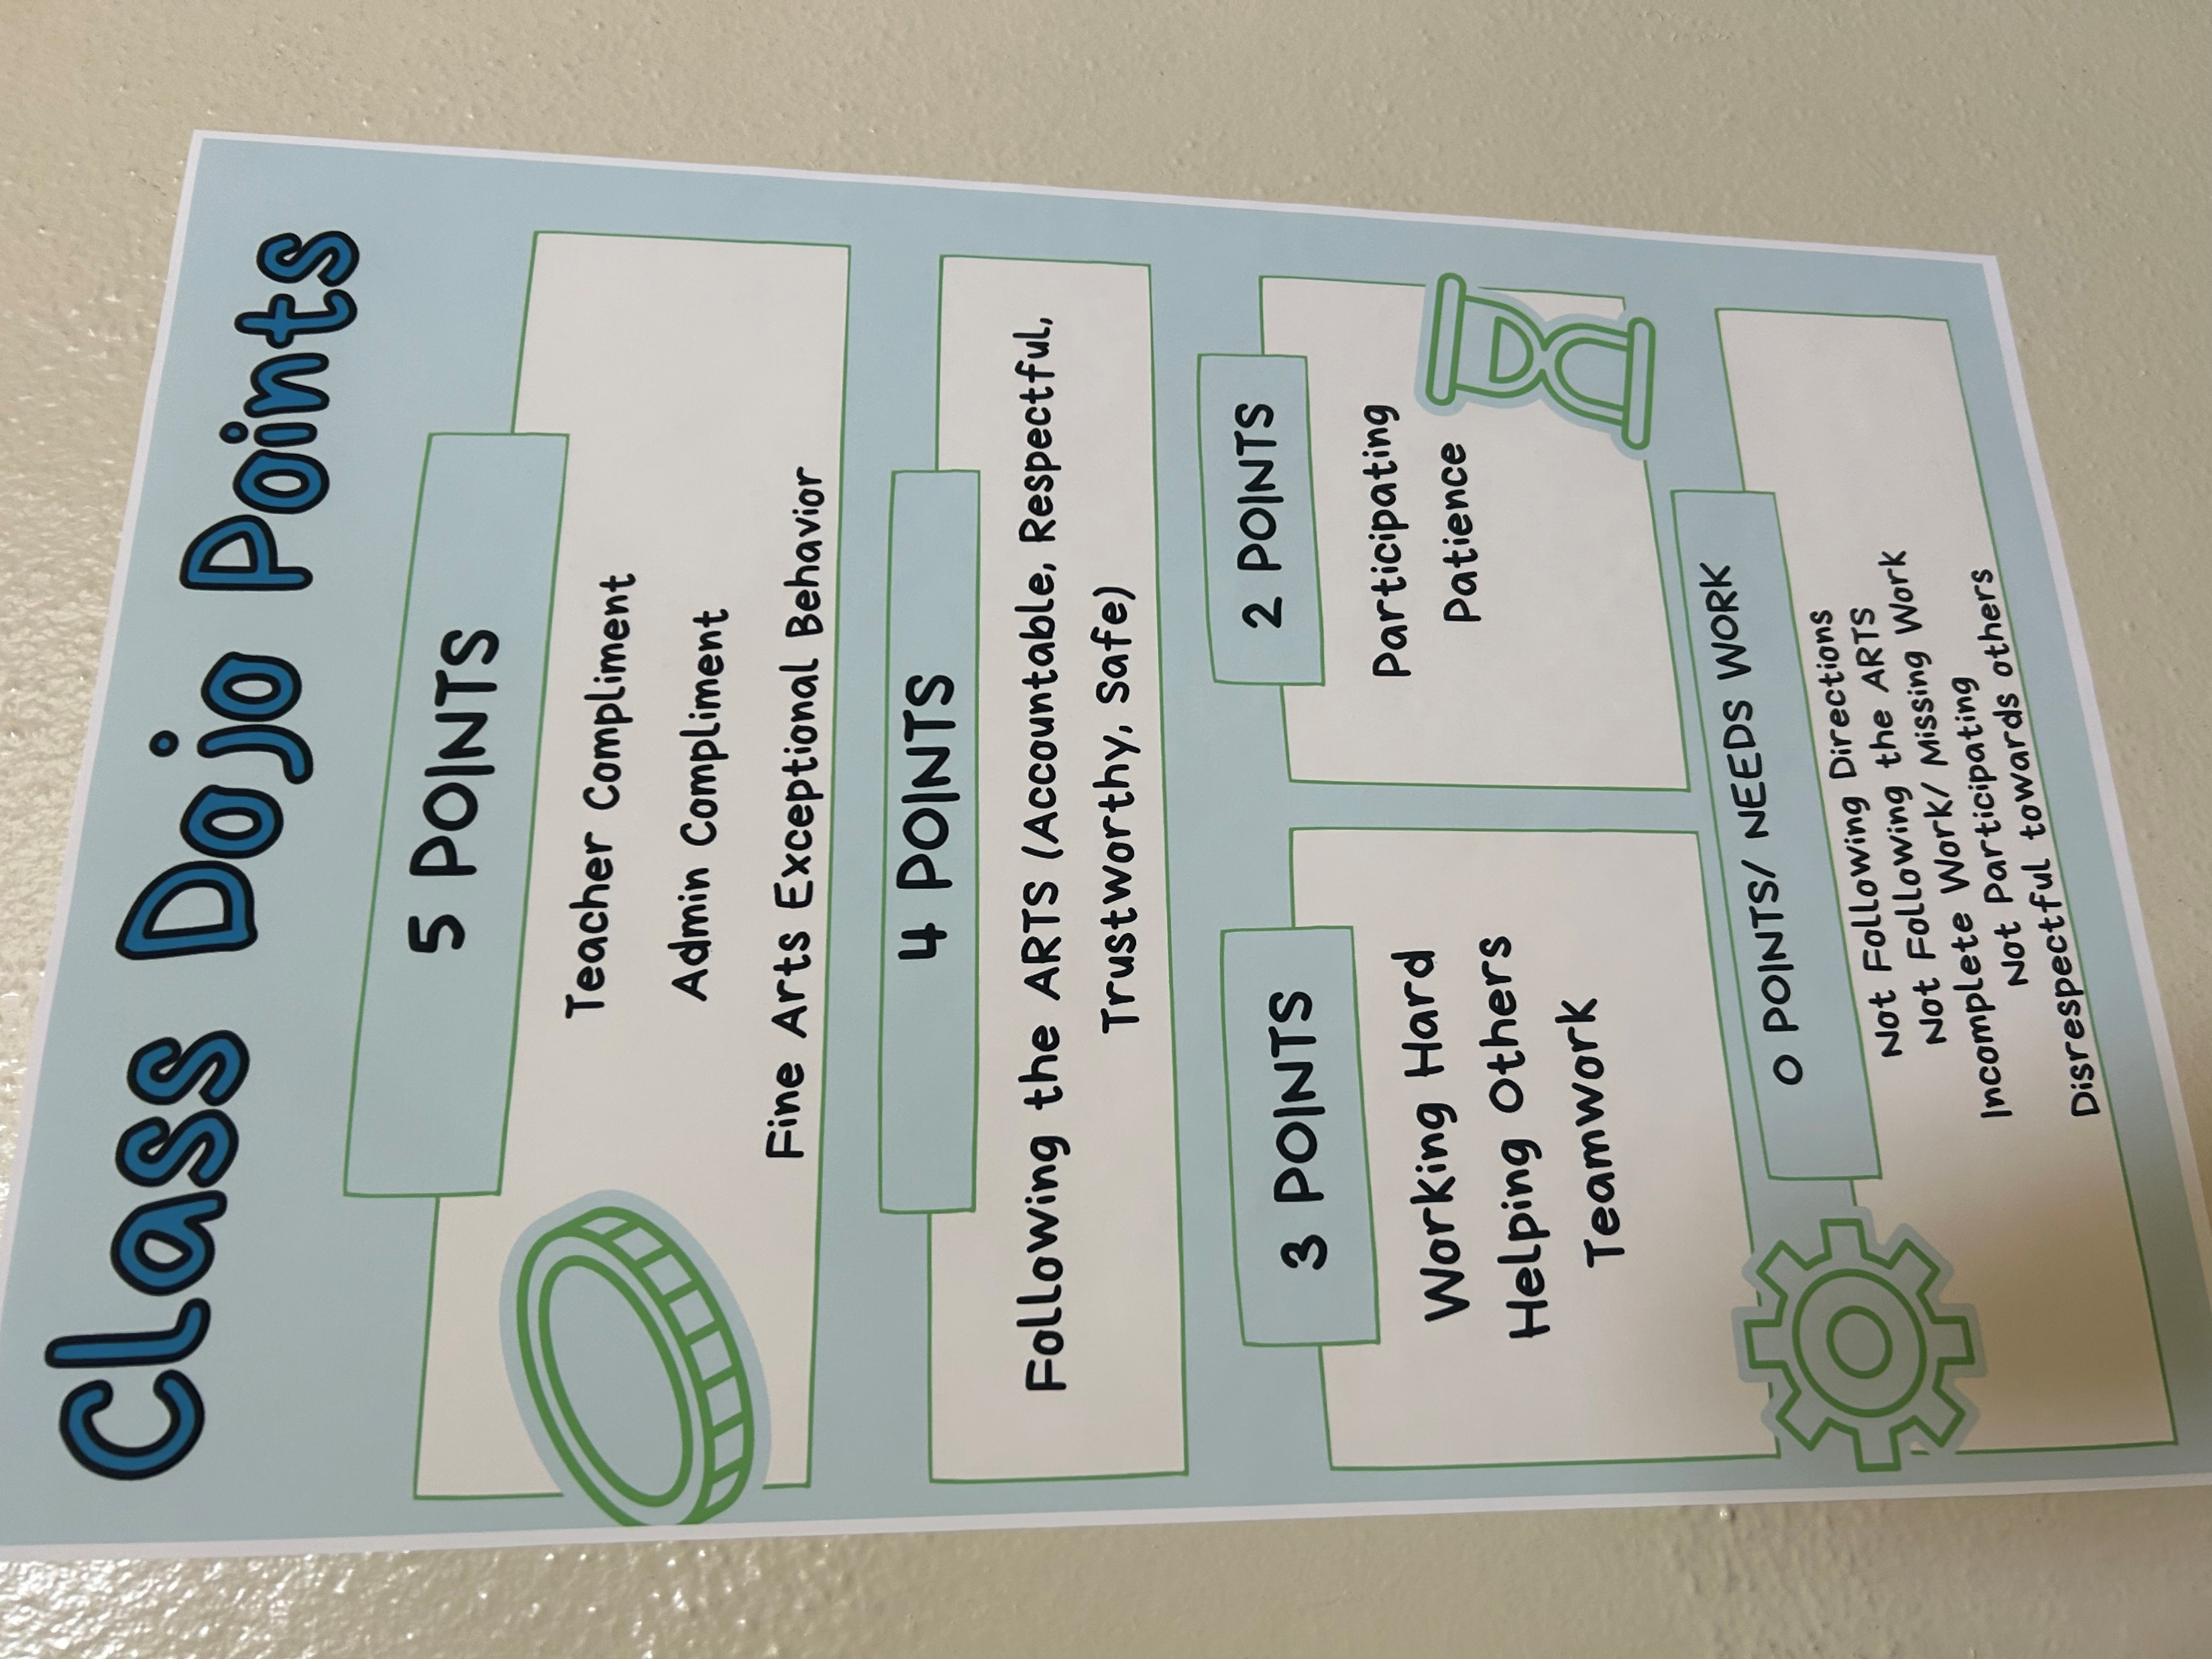


Slide 19
Some RULES to think about
Restrooms
Hallways
Water Bottles
Backpack
Toys
No Cell Phones
Sign forms
FLEXIBLE SEATING

Slide 20
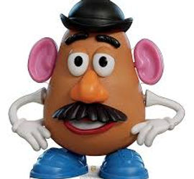
Project Time
Due Monday, August 11
https://lesterkimberly.wixsite.com/hannanf2g/potato-head-2020

